Slide 1
Current Developments and Best Practices for Today’s CFOs and Controllers
TCFO/24/V1

Slide 2
Course Outline
Introduction
How to Achieve Success
Understanding Why Organizations Are Successful
Having the Best People
Trends in Employee Motivation
Economic Update

Slide 3
A Quick Word on Policy vs. Politics
Many times when discussing accounting, tax and finance policy issues, it can be difficult to divorce the politics from the policy
Today, when discussing the various issues we will encounter over the next several hours, let’s agree to keep our own view of politics out of the application of the policy and focus on doing the very best we can for all our clients
This goes for religious/faith views as well

Slide 4
Chapter 1
Introduction

Slide 5
Introduction
Goals of the program
Make you more valuable
Make your organization more valuable

Slide 6
Prepare to Be Frustrated
This seminar is for decision makers
You will learn and discuss the right way to do things
In some situations, you do not have the power to make change --
That is frustrating

Slide 7
We Won’t Cover All
Far more material included in the materials than we can ever cover in an 4-hr. program
Great reference materials to take home
Speak up if you want to delve more deeply into any one area
Otherwise we will go through with flexibility according to discussion

Slide 8
It’s All About Change
Is your organization changing as fast as the world around it?
If not, it will fail or be bought out by another who is changing
Changes in
Economy
Organizations
Society
Employees

Slide 9
Program in Two Parts
The job of the finance professional
Leadership
Knowing technical issues
Which is more important?
This will be primarily about leadership issues
Along with an economic update

Slide 10
According to Business Insider
Finance professionals MUST
Become analytical wizards.
Manage increasing risks.
Adapt to new technology.
Be better at leading people.
Guide decisions in a politically charged atmosphere.
Manage big data.
Make effective decisions from data from outside the organization.
Understand business drivers from outside the organization.
Make better hiring decisions.

Slide 11
Chapter 2
How to Achieve Success

Slide 12
Learning Objectives
Upon completing this chapter, the reader will be able to:
Understand what is needed for organization’s success;
Know who are and who are not the customers;
See a quick way to improve customer service
Understand what has happened to customer service with the pandemic

Slide 13
What is Success?
Profits?
Market share?
Achieving vision
Serving the public?

Slide 14
Activity
For your organization how would you define success?
How will you measure if you have achieved it, or are moving toward it?
This is possibly the most important thing you will do to becoming a more successful organization

Slide 15
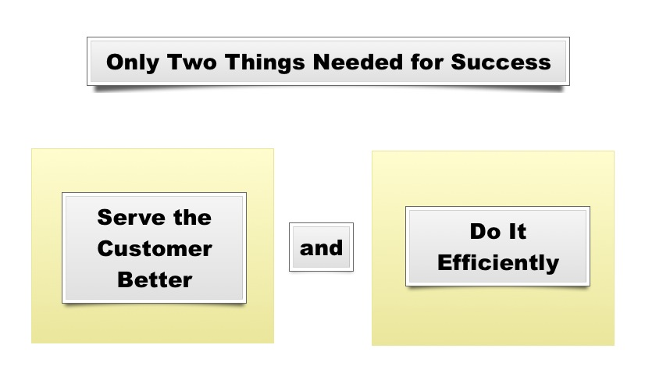
Two Things Needed for Success

Slide 16
What About Monopolies?
Do they have to serve customers well?
Do they?
What if they don’t?
Do they have to be efficient?
Are they?
What if they are not?
What about the government?

Slide 17
Who Are the Customers?
External:
The ones served by the organization
Internal:
The ones served by the department

Slide 18
Who Are Not the Customers?
Stakeholders:
Owners
Regulators
Auditors
Suppliers
They are important, but not the customers

Slide 19
Activity
Think about some of the worst customer experiences you have had
What do you think was the cause?

Slide 20
Customer Service is More About Systems Than People
Waiting on hold
Waiting in line
Not receiving what you want
Filling out more forms (often obviously needless)

Slide 21
A “Must” Question for Each Customer
How do customers determine value?
Determine for each one on your customer list

Slide 22
Customer Service Improvement
Make a list of all contacts between customer and department
For each contact, talk about how you could deliver service – what would it look like?
Wow
Average
Poor
Devise a plan of improvement

Slide 23
Brings Up a Huge Question
What is more important:
Customer service; or
Compliance?

Slide 24
What About Efficiency
The remainder of the program will be dealing with the efficiency perspective

Slide 25
Chapter 3
Understanding Why Organizations Are Successful

Slide 26
Learning Objectives
Upon reviewing this chapter, the reader will be able to understand:
Understand the keys to an organization’s success
Know the different organizational cultures
See the advantages and disadvantages of the different cultures
Understand the trend in organizational cultures

Slide 27
Activity
Make a list of successful organizations
Make a list of unsuccessful organizations
Remember these lists, we will come back to them

Slide 28
What Is Culture?
How the organization works
How decisions are made
Who gets hired, fired, and promoted
How people are motivated

Slide 29
Charles Handy and Culture
British consultant
Understanding Organizations

Slide 30
Four Key Cultures
Power
Role
Task
Person

Slide 31
Specific Aspects of the Organization
Leader
Goal
Employee identity
Change
Values
Control
Learning
Focus

Slide 32
Specific Aspects of the Organization (Cont.)
Trust
Hiring policy
Work rules
Dress code
Information
Parking

Slide 33
Best Cultural Fits
Power
Role
Task
Personal

Slide 34
Activity continued
Is there a correlation between culture and successful organizations?

Slide 35
Best Cultural Fits
Power
Role
Task
Person

Slide 36
Trends in Cultures
Move toward the task culture
Generally more customer friendly
Generally more efficient

Slide 37
Proactive Approach to Culture
What do we want?
How are we going to get it?
How each decision will affect culture
Watch unintended consequences for each action
Chief culture officer

Slide 38
Has Culture Been Affected By Covid-19
Cultures reacted to the pandemic based on their culture
Power, the boss speaks
Fast change
Role
Follow CDC
Slow change
Team
Faster change
Better customer service

Slide 39
Chapter 4
Having the Best People

Slide 40
Learning Objectives
Upon reviewing this chapter, the reader will be able to:
Recognize the best employees we need to have an excellent organization
Gain interview skills to get the best employees
Understand personality types
See how emotional intelligence is vital to success

Slide 41
If You Are Going to Be the Best
You have to have the best people
Steve Jobs:
“NO Bozos allowed”
Relationship between success and people

Slide 42
Which Is More Important?
Technical skills; or
People skills

Slide 43
Technical Skills
Testing
Experience
Education
certifications

Slide 44
Attitude
Desire
Excitement
Compatibility
Collaboration
creativity

Slide 45
For Which Do We Usually Hire?
Why do we often make the mistake?

Slide 46
Tom Cook from Apple says
Collaborate
Creativity
Curiosity
Experience
Ambition supporting the company culture

Slide 47
Google Says
Humility
Clarity of vision
Leadership
Teamwork
Cognitive ability
Algorithmic thinking

Slide 48
Which Is Easier to Train?
Technical skills; or
People skills

Slide 49
The Importance of EQ
Emotional Intelligence:
The key to getting along
The key is to understand other people and adapt to get along with them

Slide 50
Understanding Other People
Observe other people
Predict what social style they are
Know better how to deal with them

Slide 51
Two Dimensions to Style
Assertiveness
Responsiveness

Slide 52
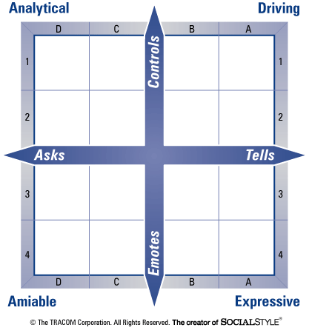
Social Style Model

Slide 53
Activity
You are new controller to a small organization. Susan is the CEO. You want to formalize expense reimbursement system. What is your central argument if Susan is a:
Driver
Expressive
Analytic
Amiable

Slide 54
Importance of Diversity
Importance of difference of thought
Understanding different customers

Slide 55
How to Obtain The People We Want
Technical skills – resume
Attitude - Interview

Slide 56
How to Have Both
Determine benchmark for technical skills
Verify technical skills:
Education
Experience
Testing
Credentials
Interview only those who pass the benchmark
Interview only for people skills
Make final decision based on people skills

Slide 57
Interviewing
Group
Case studies

Slide 58
Interviewing Questions
Determine what you want
Develop an interview question that seeks to determine that trait
Determine how you grade the answer

Slide 59
Activity – Accounts payable case study
You are the accounts payable clerk for a relatively large organization. Your job is to pay the accounts as you receive them. They have already been approved, so approval is not your job. Many of the accounts you pay come as expense reimbursement requests from the sales department. In such cases, all you have to do is to double check and make sure that the requests have been approved by the head of accounting and also the sales manager. If those approvals are on the request, your instructions are to pay the request.
One day you get a request that seems familiar. Because you are curious, you check in the file and find that the same salesperson submitted a request last month listing the same customer, at the same restaurant, and for exactly the same amount. The only difference is that the backup to the request this month was a credit card receipt and last month it was the restaurant receipt.

Slide 60
What Do You Do?
Nothing. Your job is to pay not approve
Alert salesperson of possible mistake
Go to your boss and ask what to do
Go to salesperson’s boss and report possible fraud

Slide 61
Job Descriptions and Salary Ranges
Pros and cons
What is the trend?

Slide 62
Chapter 5
Trends in Employee Motivation

Slide 63
Learning Objectives
Upon reviewing this chapter, the reader will be able to understand:
What causes employees to be motivated
How to structure an incentive system
How to organize the department for productivity
What to do with a problem employee

Slide 64
Employee Motivation
The old way:
Carrot and stick:
“You do good, you get a raise;
You do bad, you get fired”
The new way:
Still includes money at the lowest levels

Slide 65
Pandemic and Motivation
Employees love to work from home
They discovered flexibility, autonomy,
Working at home situations do what to productivity
Increase?
Decrease?

Slide 66
Compensation and Fairness
Money is not the most important thing unless people connect it to how much the company values them. At this point it is more of an ego or acceptance need.

Slide 67
Salary Administration and Cultures
Power – set by the boss
Role – time in grade
Collaborative – Value to the organization

Slide 68
Activity
Two women work in the same department for the same organization. Susan is 46 years old, has had 15 years’ experience in the organization, and has a master’s degree. She would be rated a “good” employee; however, sometimes fellow employees complain about her negative attitude. Her immediate supervisor says that she does an adequate job, but seldom volunteers for additional responsibility or work.
Ann has essentially the same job as Susan. She is 30 years old, has an undergraduate degree, and has seven years’ experience with the organization. She would be described as an “excellent” employee with great support from everyone on the staff. They especially enjoy her positive attitude and willingness to pitch in and help. Her immediate supervisor praises her attitude as well as her productivity.
In your opinion, who should be making a higher total compensation? How would you describe “fair” salary administration in this situation?

Slide 69
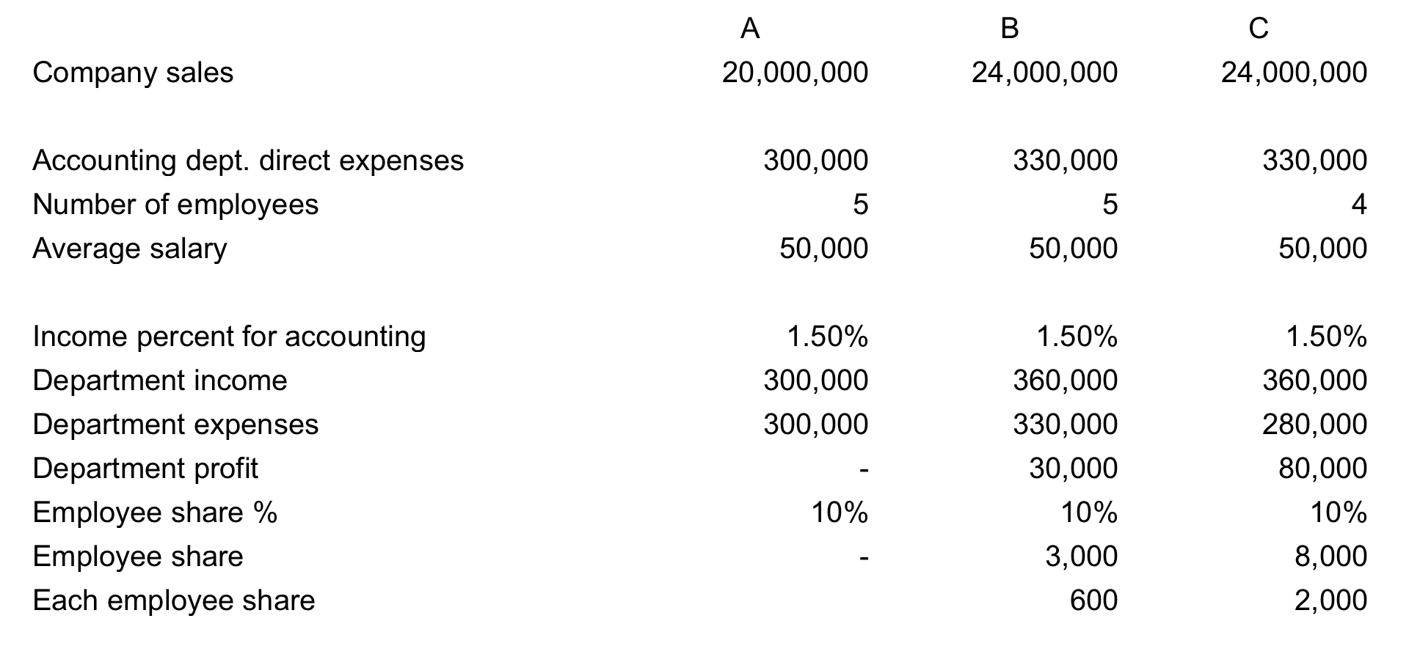
Gain Share Systems

Slide 70
“Drive” BY Henry Pink
Autonomy
Mastery
Relevance

Slide 71
Autonomy
Pay people to do work, not put in time
Central theme of google
Opposite of micromanagement
Working from home
No program is charting computer time
Metrics needed to follow results

Slide 72
Activity
Think of some ways to increase autonomy in your department

Slide 73
Mastery
People want to improve
Education
Read books
Creativity
Make mistakes

Slide 74
Activity
What are some things that your company can do to increase mastery?

Slide 75
Relevance
What I do is important
Especially important to younger people
Allow employees company time for volunteer work

Slide 76
Activity
What policies can be put in place in your company to increase relevance?

Slide 77
Empowerment
Empowerment is defined as the giving or delegation of power or authority
Empowerment and culture
Power
Role
Collaborative

Slide 78
Respect
Employees DEMAND respect
Otherwise, they will go elsewhere
Respect and customer service

Slide 79
What Employees Desire
Honest feedback
Caring for employees
Support
Collaboration
Caring for the individual

Slide 80
Problem Ownership
What really is the problem?
How to present the problem:
I messages vs. you messages

Slide 81
Terminating Employees
We primarily terminate because employees are unwilling to change behavior
Set it up so they fire themselves:
“Tom, if you repeat this behavior one more time, you are making a decision to terminate your relationship with this company. I will not be terminating you, you will be terminating yourself due to your decision. Do you understand?”

Slide 82
Chapter 6
Economic Update

Slide 83
Learning Objectives
Upon completing this chapter, the reader will be able to:
Recognize key emerging economic trends
See how micro and macroeconomics work together
Understand how new things like the cloud and social media affect our organizations
Better predict what may happen to our business

Slide 84
Why Economics Is Important To You
You are the numbers person therefore
You are the company economist

Slide 85
Microeconomics

Slide 86
Key Economic Trends
Globalization
Industrial to knowledge economy
The connected economy
Non-employee employees
Retail to the Web
Technology to the cloud

Slide 87
Microeconomics and Trends
Elements of production changing:
We need creative people
Spoiled customers
Hyper competition

Slide 88
Disintermediation
Cutting out the middleman
Examples
Manufacturer directly to the customer
On-line education
Internet if usually the vehicle used

Slide 89
Activity
How might disintermediation affect your organization?
Are there any ways that you can become the one doing the disintermediation?

Slide 90
Activity
What trends can/will affect your organization

Slide 91
Macroeconomics

Slide 92
Money Supply
Must remain in balance to growth in GDP
Too much money = inflation
Too little money = lack of growth
Definition of money
Medium of exchange or store of value
For regulatory purposes
Cash and currency + demand deposits in commercial banks

Slide 93
How is Money Created?
Government spends more than it takes in
Deficit spending
Banking system
When a loan is made, money supply increases
When a loan is repaid, money supply declines

Slide 94
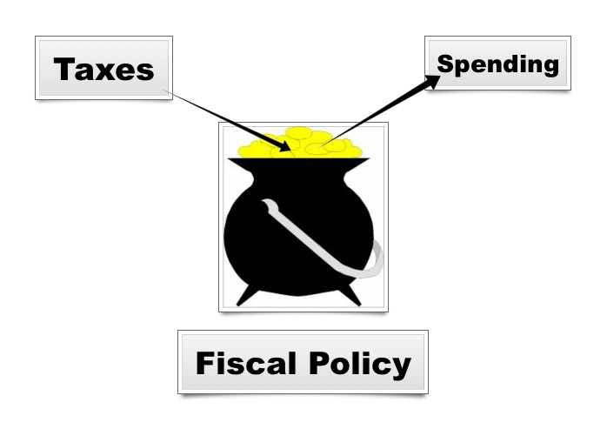
Fiscal Policy

Slide 95
Monetary Policy
Controlling the amount of new money that the banks can create
Discount rate
Fed funds rate
Reserve requirements
Open market operations

Slide 96
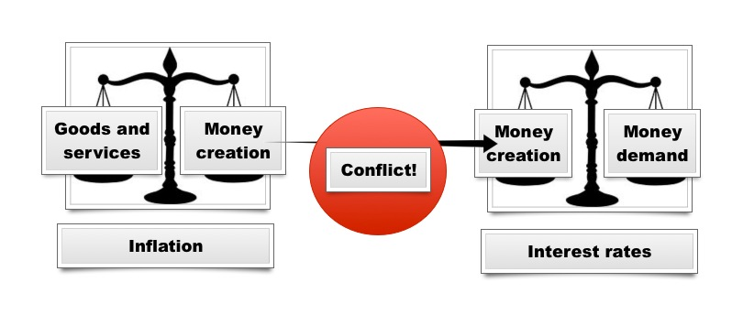
Monetary Policy

Slide 97
What’s Happening Now
Prior to pandemic, things in balance
Pandemic
Government closed much of the economy
A lot of deficit spending to offset
Probably went too far
Fiscal policy allowed money supply to grow too fast
Inflation resulted
Fed increasing interest rates to try and bring down money supply growth
Conflict between monetary and fiscal policy

Slide 98
Economic Predictions
Views of many economists as well as the author
Economic growth
Some indicators up, others down
Prediction is continued slowing of GDP and housing
Probably continuing into employment
Fed is hoping for a “soft landing,” may pull it off
Interest rates
Continue up a little more and then drop as economy falters

Slide 99
Thank you!

