Slide 1
Examining ASC 842, Leases:
More Than Meets the Eye
NLS4/24/V1

Slide 2
This Product Is Intended To Serve Solely as an Aid in Continuing Professional Education
Due to the constantly changing nature of the subject of the materials, this product is not appropriate to serve as the sole resource for any tax and accounting opinion or return position, and must be supplemented for such purposes with other current authoritative materials
The information in this course has been carefully compiled from sources believed to be reliable, but its accuracy is not guaranteed
In addition, Surgent McCoy CPE, LLC, its authors, and instructors are not engaged in rendering legal, accounting, or other professional services and will not be held liable for any actions or suits based on this manual or comments made during any presentation
If legal advice or other expert assistance is required, seek the services of a competent professional

Slide 3
A Quick Word on Policy vs. Politics
Many times, when discussing accounting, tax, and finance policy issues, it can be difficult to divorce the politics from the policy
Today, when discussing the various issues we will encounter over the next several hours, let’s agree to keep our own view of politics out of the application of the policy and focus on doing the very best we can for all our clients
This goes for religious/faith views as well

Slide 4
Course Learning Objective
After completing this course, you should be familiar with:
  An overview of the FASB’s comprehensive new lease accounting guidance, found in ASU No. 2016-02, Leases (Topic 842)

Slide 5
The End of ASC 840 Is Here…
New ASU (2016-02) issued in February 2016
New Codification Topic – ASC 842, Leases:
  Supersedes Topic 840, Leases
Applies to all leases except:
  Leases of intangible assets, inventory, and assets under construction
  Leases to explore for or use minerals, oil, natural gas, and similar non-regenerative resources
  Leases of biological assets, including timber
No “low-value” exemption, but entities should apply a reasonable capitalization policy

Slide 6
The Beginning of ASC 842 Is Here…
Effective now for all entities
As of effective dates:
  Public companies – Fiscal years beginning after December 15, 2018
  Private companies – Per ASU No. 2020-05, the effective date is for fiscal years beginning on or after December 15, 2021
Modified, not full, retrospective method to prior years

Slide 7
ASC 840 to ASC 842: Differences and Similarities
Differences | Similarities
Operating leases on balance sheet Capital leases are now finance leases Lease classification No deferred or prepaid expense Initial direct costs Footnote disclosure Centralized recordkeeping | Income statement unchanged Capital and finance lease calculations Renewal criteria: Reasonably assured = reasonably certain Remeasurement and modification accounting

Slide 8
Topic 842: The Big Changes
Topic | Guidance | Impact
Definition of a lease | A contract that conveys a right to control an identified asset | Greater emphasis on the concept of control in determining whether a lease exists
Lease classification | Removal of bright lines for classification of leases as financing or operating by lessees | Greater use of judgment in determining lease classification
Balance sheet presentation | Recognition of a right to use asset and related lease liability for all leases for lessees | Currently, only capital leases require balance sheet recognition for lessees
Income statement presentation | For lessees, the recognition, measurement, and presentation of expenses and cash flows should not change significantly. Recognition of selling profit for lessor sales-type leases may change under the control model | Right-of-use asset representing operating lease will now be subject to impairment testing for lessees

Slide 9
Topic 842: The Big Changes
Topic | Guidance | Impact
Inception vs. commencement date | Lease classification, recognition, and measurement are done at the lease commencement date, the date which the lessor makes the underlying asset available for use by the lessee | Under ASC 840, assumptions relevant to classification and measurement are determined at the lease inception. Recognition begins at the commencement date
Lease reassessment | Lessee is required to reassess lease term if a triggering event controlled by the lessee occurs or an option is exercised, or not exercised, as planned; this leads to remeasurement and potential reclassification | Current guidance requires no reassessment unless the lease is modified, or an option is exercised
Lease modifications | A lease modification is a change to the contractual terms of the lease that results in a change of scope or consideration | Current guidance on modifications is complex and confusing, resulting in difficulty in differentiating between a lease modification and termination

Slide 10
Topic 842: The Big Changes
Topic | Guidance | Impact
Sale-leaseback transactions | Sale-leaseback treatment is only obtained if transaction meets the sales guidance found in ASC 606 and the leaseback is not a finance lease | Current rules are very detailed, especially those related to real estate transactions and only applicable to lessees
Built-to-suit transactions | Ownership by lessee in construction period based on control model | Replaces current complex, prescriptive model based on a risks-and-rewards model
Initial indirect costs | Defined as incremental, initial costs that would not be incurred if the lease had not been obtained | Certain incremental costs currently capitalized will now need to be expensed, including external legal fees

Slide 11
ASU No. 2018-01: Leases
Update provides practical expedient for accounting for land easements which exist or expired prior to Topic 842 effective date and were not previously accounted for as leases under Topic 840
Current diversity in practice in accounting:
  Leases
  Intangible assets
  Property, plant, and equipment
Added cost and complexity to apply Topic 842 transition guidance to land easements

Slide 12
ASU No. 2018-01: Leases
For land easements that exist or expired before effective date of Topic 842:
  Entities can choose not to evaluate such easements under Topic 842 if such easements were not previously accounted for as leases
  Topic 842 should be applied to new or modified easements
If not electing the expedient or if ineligible to use it, entity should evaluate such leases in accordance with Topic 842
Effective date and transition is same as Topic 842

Slide 13
ASU No. 2018-10: Technical Corrections to Topic 842
Action taken at June 21, 2017, FASB meeting
FASB Update addresses 16 proposed technical corrections and improvements to Topic 842
All 16 would clarify rather than change the lease standard
Effective date for amendments is the same as for Topic 842

Slide 14
Topics Covered by ASU No. 2018-10
Area for Correction or Improvement | Summary of Change
Residual value guarantee by seller-lessee in a sale-leaseback transaction | Corrects cross-reference between guidance in Topic 460, Guarantees and Topic 842, regarding this issue
Rate implicit in the lease | Clarifies that a negative rate implicit in the lease is not appropriate and that a Day 1 loss for a sales-type lease with significant variable payments is intended. ASU No. 2021-05 addresses this concern.
Lessee reassessment of lease classification | Clarifies that an entity should reassess classification on the basis of facts which exist as of the date of the reassessment or the modification effective date
Lessor reassessment of lease term and purchase option | Clarifies when a lessor would account for the exercise of a lessee option as a lease modification

Slide 15
Topics Covered by ASU No. 2018-10
Area for Correction or Improvement | Summary of Change
Subsequent measurement of variable lease payments that depend on an index or rate | Clarifies that a change to a reference index or rate does not constitute the resolution of a contingency subject to 842-10-35-4(b)
Evaluation of investment tax credits | Alignment of terminology used in definition of rate implicit in lease to that in the glossary
Lease term and purchase option | Clarifies guidance on issue to better align with description of a noncancelable period of a lease
Amounts previously recognized in a business combination | Clarifies intent of transition guidance for lessors for assets or liabilities recognized in accordance with Topic 805, Business Combinations

Slide 16
Topics Covered by ASU No. 2018-10
Area for Correction or Improvement | Summary of Change
Nonqualifying initial direct costs for previously classified operating leases | Clarifies the transition guidance applicable to lease origination costs incurred by the lessee for existing operating leases that don’t meet the definition of initial direct costs under Topic 842
Leases previously classified as Capital Leases under Topic 840 | Corrects a reference to transition guidance to lessees for leases classified as capital and finance leases under Topics 840 and 842, respectively
Lessor accounting for modification of direct-financing or sales-type leases | Clarifies a reference to transition guidance to lessors for leases classified as sales-type and direct-financing leases under both Topics 840 and 842, respectively
Transaction guidance on sale-leaseback transactions | Clarifies effectiveness of guidance for sale-leaseback transactions

Slide 17
Topics Covered by ASU No. 2018-10
Area for Correction or Improvement | Summary of Change
Impairment of net investment in lease | Clarifies the application of the impairment guidance for net investment in the lease
Accretion of unguaranteed residual asset upon the sale of a lease receivable | Clarifies that a lessor is permitted to continue accreting the unguaranteed residual value to its estimated value over the remaining lease term in certain instances
Determination of the rate implicit in a lease with initial direct costs | Clarifies for lessors the effect that initial direct costs have on the determination of the rate implicit in the lease for classification purposes
Accounting for a failed sale-leaseback transaction | Seller-lessee in a failed sale-leaseback transaction should adjust the interest rate on its financial liability as necessary to ensure the interest does not exceed total payments on the liability

Slide 18
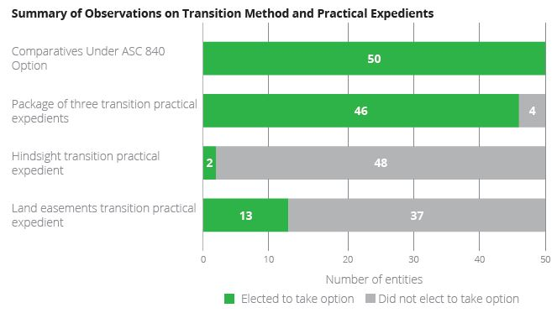
Feedback From Public Business Entity Adoption of Topic 842
Source: Deloitte Review of 50 of Fortune Top 125 disclosures

Slide 19
Other Updates to Topic 842
Under ASU No. 2018-11, lessors will have the option to aggregate non-lease components with the related lease component upon adoption of the new standard if the following conditions are met:
  The timing and pattern of transfer for the non-lease component and the related lease component are the same; and
  The standalone lease component would be classified as an operating lease if accounted for separately

Slide 20
ASU No. 2019-01
ASU issued in March 2019
Update provides guidance on two reporting issues:
  Update reinstates ASC 840 fair value exemption for lessors who are not manufacturers or dealers
    Exemption was not included in Topic 842 originally
    Use of cost, less volume or trade discounts as fair value for fair value of leased property
  Guidance on classification of cash flows by lessors
    Update clarifies that all entities within the scope of ASC 942 will present “principal payments received under leases” within investing activities
    Other entities within the scope of Topic 842 should present such activities as cash flows from operations

Slide 21
ASU No. 2019-01: Disclosure Changes and Effective Date
Update clarifies FASB’s intent to provide exception to certain ASC 250-10-50 disclosure requirements for interim reporting:
  Original text exempted entities from making the following transition disclosures in ASC 250-10-50-1(b)(2), for current and retrospectively adjusted periods:
    Change in income from continuing operations and net income
    Changes in any other affected financial statement line item
    Changes in any affected per-share amount
Updates effective for years beginning after December 31, 2019, for public business entities, certain NFPs and EBPs
  Effective date one year later for other entities
  Early adoption is permitted
Entities should apply Updates using same transition methodology

Slide 22
Issuance of ASU 2021-05
Update provides relief for lessors recording day-one losses on sales-type and direct financing leases
Leases that meet the following criteria will be accounted for as operating leases by lessors:
  Lease has variable lease payments which are not tied to a rate or index
  The lease would be classified as a sales-type or direct financing lease under ASC 842
  The lessor would record a day-one loss on the leases

Slide 23
ASU No. 2021-09 and Other Proposed Changes
ASU No. 2021-09 updated the guidance related to discounts rates
  Election of risk-free rate by class of asset by private entities
    Prior, when a private entity can’t determine the rate implicit in a lease, it may elect to use the risk-free rate for the discount rate, with the election applying for all assets
    This ASU allows such entities to elect to use the risk-free rate, as opposed to their incremental borrowing rate, on a class of asset basis
The FASB’s Post-Implementation Review (PIR) of ASC 842
  Feedback to date relates to public company implementation of ASC 842
  Potential updates to ASC 842 are likely to be identified by the PIR
  No significant updates are expected until the completion of the PIR process

Slide 24
ASU 2023-01: Leases (Topic) 842 – Common Control Arrangements
Update provides relief related to common control lease arrangements and leasehold improvements
  Provides a practical expedient that allows private companies and not-for-profits to use the written terms of the lease to determine whether a lease exists as well as the classification of and accounting for that lease
    Prior to this update, lease terms were required to be legally enforceable
    This practical expedient does not apply to verbal leases. The lease must be in writing.
  Entities may apply the above practical expedient in two ways:
    Prospectively to leases that commence or are modified on or after the date that the entity first applies the amendment; or
    Retrospectively to the beginning of the first period the entity applied ASC 842
Effective date
  Fiscal years beginning after December 15, 2023, for private companies and not-for-profits, and interim periods within those fiscal years. Early adoption is permitted.

Slide 25
Issuance of ASU 2023-01
This update also addresses leasehold improvements recognized by a lessee in a lease between parties under common control
  Previously, leasehold improvements were amortized over the shorter of the useful life of the improvements or the remainder of the lease term
  Amendments in this new update will add requirements related to leasehold improvements associated with leases between entities under common control
  Lessee will amortize the leasehold improvements over the useful life of the improvements, regardless of lease term, if the lessee controls the underlying asset through a lease
    There is an exception if the lessor controls the underlying asset through a lease with an unrelated third party. In this scenario, the amortization period for the leasehold improvements cannot exceed the lease terms between the lessor and the unrelated entity
  Once the lessee no longer controls the underlying asset, the unamortized portion of leasehold improvements will be transferred to the lessor through an adjustment to equity
This amendment will apply to all entities under common control when leases are present, not just private companies. Entities that encounter the above scenario, where leasehold improvements will be amortized for a longer period than the lease term, should disclose the following:
  Remaining lease term;
  Leasehold improvements’ remaining useful life; and
  Unamortized balance of leasehold improvements

Slide 26
Effective Date and Transition for ASU 2023-01
Transition – Related to amendment on common control leasehold improvements
  Prospectively to new leasehold improvements recognized on or after the date the above amendments are first applied
  Prospectively, as noted above, while also amortizing existing leasehold improvements over the remaining useful life determined at the date of application
  Retrospectively to the beginning of the first period the entity applied ASC 842 for leasehold improvements that exist at the date of adoption of this amendment, with any leasehold improvements that otherwise would not have been amortized recognized through a cumulative-effect adjustment to the opening balance of retained earnings at the beginning of the fiscal year of adoption
Effective date – Related to amendment on common control leasehold improvements
  Fiscal years beginning after December 15, 2023, for all entities, and interim periods within those fiscal years. Early adoption is permitted

Slide 27
The New Lease Accounting Guidance From 30,000 Feet

Slide 28
New Lessee Accounting Model
Core Principle – Recognize assets and liabilities for leases with a lease term > 12 months
“Right-of-use” (ROU) asset to use leased asset for lease term and liability to make lease payments
Accounting depends on who controls underlying asset

Slide 29
Finance Leases
Generally is the classification for most leases of assets other than property
ROU asset and lease liability – Initially measured at PV of lease payments
Unwinding of discount on lease liability as interest separately from amortization of ROU asset

Slide 30
Operating Leases
Generally is the classification for most leases of property
ROU asset and lease liability – Initially measured at PV of lease payments
Single lease expense – Unwinding of discount on lease liability combined with amortization of ROU asset on straight-line basis
The initial entry to record an operating and finance lease is the same. The subsequent accounting is different

Slide 31
Lessee Determination of Finance or Operating Lease
Look to similar factors used in U.S. GAAP today:
  Payments represent substantially all of the asset fair value
  Lease term is for a major portion of asset’s life
  Bargain purchase option
  Title transfer at end of the lease
  Underlying asset is of such a specialized nature that it has no alternative use for the lessor at lease end
No bright lines for fair value and asset life tests
Calculation used for determining lease classification is generally the same as that for determining lease liability
  Full amount of residual value guarantee included in the fair value classification test
IFRS 16 only has one classification of leases, as finance leases

Slide 32
New Lessor Accounting Model
Sales-type/direct financing vs. operating – Depends on whether the lease is effectively a financing or a sale transaction, rather than an operating lease
Assess if lease transfers substantially all risks and rewards of ownership of underlying asset
No recognizing selling profit and revenue at lease commencement for a lease that does not transfer control of underlying asset to lessee:
  Key accounting difference between sales-type and direct financing lease

Slide 33
New Lessor Accounting Model
Sales-type/direct financing – Similar to existing sales-type/direct financing lease accounting:
  Derecognize underlying asset
  Recognize selling profit either immediately or over lease term
Operating – Similar to existing operating lease accounting:
  Continue to recognize underlying asset
  Recognize lease income over lease term typically on S/L basis
Standard includes concept of collectability from ASC Topic 606, Revenue from Contracts with Customers:
  Could prevent lessor accounting for lease as a sale

Slide 34
The New Lease Accounting Guidance

Slide 35
What Is a Lease?
Contract that conveys right to use an asset for a period of time in exchange for consideration
Use of identified asset explicitly or implicitly specified and customer controls use of identified asset

Slide 36
Is It a Lease?
Contract for use of 10 shipping containers of particular specifications, kept on customer’s premises
Carrier cannot retrieve containers during contract
Customer directs the use of the containers
Customer can receive a replacement when one needs repair

Slide 37
Is It a Lease?
Contract for use of 10 shipping containers of particular specifications, kept on customer’s premises
Carrier cannot retrieve containers during contract
Customer directs the use of the containers
Customer can receive a replacement when one needs repair
Yes. As leased assets are specifically identified and customer controls their use, this would be considered a lease.

Slide 38
What If?
Carrier had the right to substitute one of the 10 identified containers?

Slide 39
What If?
Carrier had the right to substitute one of the 10 identified containers?
Right of substitution would prohibit the contract from being accounted for as a lease. It would be accounted for as a service contract.

Slide 40
Is It a Lease?
Customer enters into a contract for copying machines for three years and controls usage
Customer must buy all supplies from machine supplier
Supplies are available from other vendors
Supplier would replace a machine only if it is not working properly

Slide 41
Is It a Lease?
Customer enters into a contract for copying machines for three years and controls usage
Customer must buy all supplies from machine supplier
Supplies are available from other vendors
Supplier would replace a machine only if it is not working properly
Yes. The machines are identified, and the customer controls their usage. As supplies can be obtained from another vendor, the customer is able to derive the benefits from use of the machines on its own.

Slide 42
Is It a Lease?
Customer enters into a contract for beverage services for two years. The Supplier puts five beverage machines in Customer’s facility that are tailored for use with beverage consumables provided by Supplier
The beverage machines function only with the consumables provided by Supplier and have no use to Customer other than when they are used in conjunction with those consumables
Supplier is responsible for repairs and maintenance of the beverage machines. Customer’s staff operate the machines, that is, they select the beverages they wish to drink, and the machines deliver the beverage

Slide 43
Is It a Lease?
Customer enters into a contract for beverage services for two years. The Supplier puts five beverage machines in Customer’s facility that are tailored for use with beverage consumables provided by Supplier
The beverage machines function only with the consumables provided by Supplier and have no use to Customer other than when they are used in conjunction with those consumables
Supplier is responsible for repairs and maintenance of the beverage machines. Customer’s staff operate the machines, that is, they select the beverages they wish to drink, and the machines deliver the beverage
The contract does not contain a lease as the customer does not control the use of the beverage machine

Slide 44
Separating Contract Components
ROU asset separate lease component if:
  Lessee can benefit from use on own or together with other readily available resources
  AND
  Not dependent on/highly interrelated with other contract assets
Allocate consideration to each separate lease component

Slide 45
Separating Lease and Non-Lease Components
Lessee and lessor practical expedient to not allocate consideration to lease and non-lease components
  Lessee can elect to not separate lease and non-lease components in all leases
  Lessor can make election, per ASU No. 2018-11, only if certain conditions are met
    The timing and pattern of transfer for the non-lease component and the related lease component are the same
    The standalone lease component would be classified as an operating lease if accounted for separately
    Guidance (ASC 606 or 842) to use will be based on the predominance principle

Slide 46
What About Lessee Payments for Taxes and Insurance?
It does not matter whether the lessee directly pays a third party on the lessor’s behalf or reimburses the lessor
Inclusion of payments made by a lessee for property taxes and insurance in contract consideration will depend on whether the lessee is required to pay a fixed or variable amount
  If a lessee is required to pay a fixed amount of property taxes and insurance (related to the leased asset), such payments should be included in contract consideration
    Payments would be allocated to the lease and non-lease components by both the lessee and lessor
  If a lessee is required to pay the actual amounts for property taxes and insurance, such payments should be excluded from contract consideration and instead recorded as incurred by the lessee and earned by the lessor

Slide 47
Determining Lease Components
Lease of retail space
  A lessee enters into a lease of retail space together with the surrounding land that is used for parking and deliveries. Because of the location of the retail space, a retailer would not lease the building without the surrounding land. The lessee is a retailer that intends to use the building for its retail operations

Slide 48
Determining Lease Components
Lease of retail space
  A lessee enters into a lease of retail space together with the surrounding land that is used for parking and deliveries. Because of the location of the retail space, a retailer would not lease the building without the surrounding land. The lessee is a retailer that intends to use the building for its retail operations
This lease would have one lease component

Slide 49
Determining Lease Components
Lease of a turbine and related building
  A lessee leases a turbine plant, which consists of a large turbine housed within a building, together with the land on which the building is situated. The building was designed specifically to house the turbine and the life of the building is directly linked to the life of the turbine, that is, when the turbine can no longer be used and is dismantled, the building will be demolished or substantially rebuilt
This lease would have one lease component

Slide 50
What If?
Assume the same facts in Scenario 1 except that the contract also conveys the right to use an additional plot of land located adjacent to the retail space that could be developed independently of the retail space
The lease would have two components

Slide 51
Determining Lease Components
Lease of machinery and plant
  A lessee leases a manufacturing plant together with a large piece of equipment that is installed within the plant. The lessor does not lease or sell the equipment separately, but other suppliers do. The plant is not tailored for use only with the piece of equipment and the equipment could be used for a different manufacturing process within another plant
This lease would have two lease components

Slide 52
Allocation of Consideration to Lease and Non-Lease Components Example
Customer enters into a five-year contract with Supplier for a total consideration of $200,000, payable in five annual amounts of $40,000
The contract has two components:
  Component 1 – The lease of equipment for five years; and
  Component 2 – Maintenance of the equipment by Supplier for five years
The contract does not specify prices for the individual components

Slide 53
Allocation of Consideration to Lease and Non-Lease Components Example
The contract is priced as a package and Customer is unable to obtain an observable standalone price for the lease component. However, the customer learns that several other suppliers provide maintenance services that relate to similar equipment over a five-year period at a standalone price of $10,000 per year
Because the customer has an observable standalone price for one component of the contract, but not both, it first allocates consideration to the component with an observable price and then allocates the remaining consideration to the component without an observable price
Customer concludes that the consideration for the lease component is $30,000 per year ($40,000 per year − $10,000 per year allocated to the service component of the contract)

Slide 54
Lessee Lease Classification
Leases classified as follows:
  Finance
    Lease meets any of the five criteria discussed earlier
  Operating
    None of the five criteria are met
    Generally, leases of real estate
Bright lines of current standard removed

Slide 55
Other Guidance Related to Lessee Lease Classification
Lease should be classified as a finance lease if the lessee has a significant economic incentive to exercise a purchase option
If the lease contains a right to use more than one asset:
  Base nature of asset on the primary asset
  Use economic life of the primary asset
  If both land and a building, use life of the building

Slide 56
Lease Classification Example 1
A lease has the following key terms:
  10-year lease of equipment with a total economic life of 12 years;
  Lease payments are $9,000 per year, discounted at 5 percent;
  Present value of lease payments is $69,500; and
  Fair value of leased asset at commencement is $75,000
In applying the guidance of Topic 842, determine the appropriate classification of this lease, from the lessee’s perspective

Slide 57
Lease Classification Example 1
A lease has the following key terms:
  10-year lease of equipment with a total economic life of 12 years;
  Lease payments are $9,000 per year, discounted at 5 percent;
  Present value of lease payments is $69,500; and
  Fair value of leased asset at commencement is $75,000
In applying the guidance of Topic 842, determine the appropriate classification of this lease, from the lessee’s perspective
The entity would determine that this is a finance lease

Slide 58
Lease Classification Example 2
Facts:
  A lessee enters into a 15-year lease of an office building, which has a remaining economic life of 40 years at the commencement date
  The lease payments are $30,000 per year, the present value of which is $300,000, calculated using the lessee’s incremental borrowing rate. The fair value of the property at the commencement date is $400,000
Analysis:
  The lease is an operating lease based on the following:
    The underlying asset is property;
    The lease term is not for a major part of the remaining economic life of the property; and
    The present value of the lease payments does not account for substantially all of the fair value of the property

Slide 59
Lease Term
Used for classification purposes as well as to determine the period for which payments should be included in the lease liability
Noncancelable period lessee has right to use asset
PLUS
Option periods to extend/terminate only if significant economic incentive at commencement date to exercise/not exercise option:
  “Reasonably certain” lessee will exercise – High threshold
Begins at commencement date and includes any rent-free periods
Lessor would generally not reassess lease term without a lease modification

Slide 60
Initial Measurement of Lease Liability
Fixed payments, less any incentives receivable from the lessor
Variable lease payments that depend on an index or a rate (e.g., Consumer Price Index or a market interest rate) initially measured using the index or rate at the commencement date
Guaranteed residual value expected to be payable
Exercise price of a purchase option if the lessee has a significant economic incentive to exercise that option
Payments for penalties for terminating the lease, if the lease term reflects the lessee exercising an option to terminate the lease
Fees paid to owners of special purpose entity for structuring the transaction

Slide 61
Initial Measurement of Right-of-Use Asset
Initial measurement of lease liability
Any lease payments made at or before lease commencement date, less any lease incentives received
Any initial direct costs incurred by the lessee:
  E.g., commissions, payments made to an existing tenant to incentivize lease termination
  Costs that would have been incurred regardless do not qualify (e.g., salaries, depreciation, occupancy costs, etc.)

Slide 62
Fixed Lease Payments
Those payments required to be made under the lease contract:
  Can be a fixed amount for the term of the lease; or
  Can increase at scheduled intervals, as detailed in the lease
Include price of purchase option when “reasonably certain” of exercise
Look to substance of the payment over its form:
  Property tax example
  Leasehold improvements – Who owns the asset?

Slide 63
Variable Lease Payments
A payment that changes during the lease term due to changes in facts and circumstances that occur after lease commencement
Common variable lease provisions:
  External market rate or index (e.g., CPI or LIBOR, etc.)
  Performance of underlying asset (i.e., percentage of revenue generated from leased asset)
  Usage of asset (e.g., miles on a leased car)
Include in determination of lease liability and lease classification if tied to a rate or index:
  Use rate or index at lease commencement date
  Assume no change in rate or index

Slide 64
Variable Lease Payment Tied to an External Market Rate
A lessee enters into a lease for equipment for five years. Payment is due at the end of the year. The lease payment in Year 1 is $10,000, with the payment for Years 2-5 tied to the interest rate of the five-year U.S. Treasury security, measured annually at the anniversary of the lease commencement date
The current rate for the five-year U.S. Treasury security is 1.25 percent

Slide 65
Variable Lease Payment Tied to an External Market Rate
For purposes of determining the lessee’s lease liability for this lease, lease payments on this lease would be as follows:
  Year 1 – $10,000
  Year 2 – $10,125
  Year 3 – $10,252
  Year 4 – $10,380
  Year 5 – $10,509
The amount of the payment included in the lease liability would not change, even if the interest rate of the five-year U.S. Treasury security changes over the course of the lease

Slide 66
Variable Lease Payment Tied to an Index
Assume the same facts as above, except that the lease payment is tied to the change in the Consumer Price Index, (CPI). For example, if the CPI increases 2 percent, the lease payment would increase to $10,200. The lessee would include the amount of the variable lease payment in the calculation of the lease liability and ROU asset, as the payment is tied to a market rate or index, in this case, the CPI
However, as the change in the CPI is unknown at the lease commencement date, only the lease payments of $10,000 annually would be included in the measurement of the lease liability and ROU asset

Slide 67
Residual Value Guarantees
A guarantee made to the lessor that the value of an underlying asset returned to the lessor at the end of the lease will be at least a specified amount
May be provided by the lessee or a third party
Generally, would result in finance classification by lessees
Only amount probable of being paid is included in liability and ROU asset; full amount of guarantee used when classifying the lease

Slide 68
Discount Rate
Use rate implicit in the lease
Implicit rate is the rate where present value of lease payments and residual value equal fair value of leased asset at lease commencement
Rate may not be known by lessee:
  In such instances, lessee can use incremental borrowing rate
  Non-public company option to use its risk-free interest rate for all leases
    FASB proposal to allow election on class of asset basis

Slide 69
Accounting for Initial Direct Costs
Capitalize only those costs that entity would not have incurred if the lease had not been entered into:
  Commissions
  Payments to current tenants to obtain lease
  Legal fees are not capitalized
Lessees include such costs in measurement of ROU asset
Accounting varies for lessors

Slide 70
Lease Modifications
Defined as any change to the contractual terms that was not part of the original terms and conditions of the lease
Both lessors and lessees account for modification as a new lease when the following occurs:
  Includes ROU not in original lease; and
  Additional ROU priced at standalone price
Extension of lease term is not a modification

Slide 71
Accounting for Lease Modifications When Not a New Contract – Lessee
Lessee:
  Adjust ROU asset to remeasured lease liability if the modification:
    Grants lessee an additional right not in the original lease
    Extends or reduces the term of the lease
    Changes the consideration
  If modification partially or fully terminates the lease:
    Remeasure lease liability
    Decrease ROU asset proportionally
    Recognize gain or loss on difference between change in ROU asset and lease liability

Slide 72
Accounting for Lease Modifications When Not a New Contract – Lessor
Original lease is a sales-type lease:
  If reassessed lease is a sales-type or direct financing lease, adjust discount rate so net investment of new lease equals net investment of old lease at time of modification
  If reassessed lease is an operating lease, recognize underlying asset at amount equal to net investment in original lease at the time of the modification
Original lease is a direct financing lease:
  If classification doesn’t change, follow guidance above
  If classification changes to operating, recognize underlying asset at amount equal to net investment in original lease at the time of the modification

Slide 73
Accounting for Lease Modifications When Not a New Contract – Lessor
Accounting for modification depends on the classification of the lease both before and after modification:
  Original lease is an operating lease
    Account as a termination of original lease and creation of new lease
    Account for new lease, as per appropriate guidance, subject to certain adjustments

Slide 74
Combining Lease Contracts
Consider the guidance on combining contracts found in ASU No. 2014-09, Revenue from Contracts with Customers
Points to consider:
  Were the contracts negotiated as a package?
  Are the contracts interrelated?

Slide 75
Short-Term Leases
Lease term ≤ 12 months at commencement date (not at effective date of ASC 842)
Accounting policy election to not apply requirements (disclose):
  Made by class of asset ROU relates to
  Recognize payments in profit/loss over lease term S/L (other)
Lessor must disclose short-term lease income recognized in reporting period (tabular format)

Slide 76
Determining if a Lease Meets the Short-Term Lease Practical Expedient
A lessee has made an accounting policy election to utilize the short-term lease practical expedient
  The lessee enters into a 12-month lease of a vehicle, with an option to extend for another 12 months
  The lessee does not have a significant economic incentive to exercise the option to extend
Is this lease a short-term lease?

Slide 77
Determining if a Lease Meets the Short-Term Lease Practical Expedient
A lessee has made an accounting policy election to utilize the short-term lease practical expedient
  The lessee enters into a 12-month lease of a vehicle, with an option to extend for another 12 months
  The lessee does not have a significant economic incentive to exercise the option to extend
Is this lease a short-term lease?
  Because there is no significant economic incentive to exercise the option to extend, the lessee determines the lease term to be 12 months. As such, the entity may take advantage of the practical expedient to not recognize the right-of-use asset or lease liability in its financial statements

Slide 78
Small-Ticket Leases
High volume small-value leases (mobile phones)
Can apply guidance at portfolio level – Group contracts together:
  Similar to new revenue recognition standard
  Additional guidance will be included in “Basis for Conclusions”

Slide 79
Subleases
Intermediate lessor accounts for head lease and sublease as two separate contracts
Head lease follows lessee guidance while sublease follows lessor guidance:
  Unless contracts meet contract combinations guidance
Classify sublease based on underlying asset, not ROU asset from head lease
Sublease with PV less than original ROU asset could indicate impairment of original lease

Slide 80
Other Issues Related to Leases
Related party leasing transactions:
  Record lease for both lessee and lessor based on enforceable terms of the lease contract
  Consider verbal arrangements as well
  Consider necessary disclosures required under ASC 850, Related Party Disclosures
Leveraged leases:
  Concept eliminated in new standard
  Existing leveraged leases are grandfathered

Slide 81
Build-to-Suit Lease Arrangements
New model in Topic 842:
  Lessee is owner of asset under construction if lessee controls asset
If lessee incurs costs relating to construction or design of underlying asset before the commencement date, lessee should account for those costs in accordance with other ASC Topics, for example, ASC 330, Inventory, or ASC 360, Property, Plant, and Equipment
If lessee controls underlying asset before commencement date, transaction is a sale and leaseback accounted for in accordance with ASC 842-40-25-3 and ASC 842-40-30-1 and 30-2

Slide 82
Lessee Initial and Subsequent Accounting Guidance

Slide 83
Recognition
Covered by ASC Subtopic 842-20:
  Recognition of ROU asset and lease liability
ROU asset consists of the following:
  Initial measurement of lease liability;
  Any lease payments made at or before lease commencement date, less any lease incentives received; and
  Any initial direct costs incurred by the lessee

Slide 84
Recording of a Lease Liability
Recorded at the commencement date
Recorded at present value:
  Use the rate implicit in the lease
  Use lessee’s incremental borrowing rate if implicit rate is not determinable
Non-public entity exception:
  As a policy election, a non-public entity may use a risk-free interest rate comparable to that of the lease term for the discount rate if it can’t determine the rate implicit in the lease

Slide 85
Initial Measurement of Lease Liability
Fixed payments, less any incentives receivable from the lessor
Variable lease payments that depend on an index or a rate (e.g., Consumer Price Index or a market interest rate) initially measured using the index or rate at the commencement date
Guaranteed residual value expected to be payable
Exercise price of a purchase option if the lessee has a significant economic incentive to exercise that option
Payments for penalties for terminating the lease, if the lease term reflects the lessee exercising an option to terminate the lease
Fees paid to owners of special-purpose entity for structuring the transaction

Slide 86
Applying the Guidance
Illustration – Initial Measurement of Right-of-Use Asset and Lease Liability
Key assumptions:
  10-year lease, with option to renew for five years
  Payments are $50,000 per year, rising to $55,000 in option years
  Lessee incurs initial direct costs of $15,000
  Lessee’s implicit interest rate is 5.87 percent

Slide 87
Illustration Journal Entries
Right-of-use asset 407,017
Lease liability 342,017
Cash (Year 1 payment) 50,000
Cash (initial direct costs) 15,000

Slide 88
Accounting for a Lease With a Purchase Option
A lessee enters into a five-year lease of equipment with annual lease payments of $59,000, payable at the end of each year
  There are no initial direct costs
  At the end of Year 5, the lessee has an option to purchase the equipment for $5,000
  The residual value of the equipment in five years is $75,000
  The lessee concludes that it has a significant economic incentive to exercise the purchase option
The fair value of the equipment at the commencement date is $250,000, its estimated useful life is seven years, and the lessor charges the lessee 6.33 percent, which is the rate implicit in the lease

Slide 89
Accounting for a Lease With a Purchase Option
Journal entry to record lease
  ROU asset $250,000
  Lease liability $250,000
Subsequent accounting
  The lessee amortizes the ROU asset over the useful life of the equipment of seven years, because the lessee has a significant economic incentive to exercise the purchase option
  At the end of Year 5, the lessee exercises the option to purchase the equipment, pays the lessor $5,000, and reclassifies the ROU asset to equipment
The amount represents the present value of five payments of $59,000 plus the present value of the purchase option payment of $5,000

Slide 90
Lessee Subsequent Measurement of the Lease – Finance Lease
Finance lease:
  Expense recognition consists of two parts
    Amortization of the leased asset; and
      Generally straight line, over life of the lease
    Unwinding of discount on the lease liability as interest expense
  Unwinding of the lease liability determined as the amount that produces a constant periodic discount rate on the remaining balance of the liability
  Lease liability reduced by the amount of the cash payment, less the interest expense

Slide 91
Lease Expense Example – Finance Lease
Using previous fact pattern
Recording of lease payment and expense
Interest expense $20,076
Lease liability 29,924
Cash 50,000
  Interest expense ($342,017 x .0587)
  Lease liability reduction ($50,000 – 20,076)

Slide 92
Lease Expense Example – Finance Lease
Recording of amortization expense
  Amortization expense 40,702
  Right-of-use asset 40,702
  $407,017/10-year useful life

Slide 93
Lessee Subsequent Measurement of the Lease – Operating Lease
Expense consists of a single cost, combining amortization with unwinding of the discount:
  Periodic cost should never be less than the unwinding of the discount
Periodic expense – Total cost of lease allocated on a straight-line basis
Lease liability reduced by payment, less interest component
Credit to accumulated depreciation is the difference

Slide 94
Lease Expense Example – Operating Lease
Using previous fact pattern
Lease expense 51,500
Lease liability 29,924
Cash 50,000
Right-of-use asset 31,424
Expense ($515,000/10 years and consists of 10 payments of $50,000 plus $15,000 initial direct costs)
Interest portion is $20,076 ($342,017 x .0587)
Reduction of lease liability is $50,000 less $20,076

Slide 95
Comparison of Lease Expense
Total expense
  $51,500 – Operating lease
  $60,778 – Finance lease
Finance lease results in front-end loading of expense, due to amortization of discount

Slide 96
Impairment of ROU Asset
Must be considered in accordance with Topic 360, Property, Plant and Equipment
Record loss if carrying amount of ROU asset exceed its fair value:
  Fair value is the undiscounted cash flows derived from use of the leased asset
Higher risk of impairment with operating lease

Slide 97
Triggering Events for Assessment of Recoverability
A significant decrease in the market price of a long-lived asset
A significant adverse change in the extent or manner in which a long-lived asset is being used or in its physical condition
A significant adverse change in legal factors or in the business climate that could affect the value of a long-lived asset
An accumulation of costs significantly in excess of the amount originally expected for its acquisition or construction
A current-period operating or cash flow loss combined with a history or projection of operating or cash flow losses
A current expectation that, more likely than not, a long-lived asset will be sold or otherwise disposed of significantly before the end of its previously estimated useful life

Slide 98
Accounting After an Impairment
Finance lease:
  Revise amortization expense prospectively, based on revised ROU asset value
Operating lease:
  Lease expense no longer recognized on straight-line basis
  Record amortization on a straight-line basis
  Record interest expense using effective interest method
  Accounting effectively converts to that for a finance lease

Slide 99
Other Factors to Consider
Variable lease payments:
  For those not included in determination of lease liability, include in expense in the period in which the obligation is incurred
  Consider need to include variable lease payment in reassessment of lease liability if contingency is mitigated

Slide 100
Reassessment of Lease Liability
Remeasure liability to reflect changes to payments:
  Lease modification – Update all assumptions
  Removal of contingency around variable payments
  Change in:
    Lease term
    Having/no longer having significant economic incentive to exercise option to purchase asset
    Amounts expected payable under residual value guarantees
Consider need to reallocate lease payments to separate leased assets or non-lease components

Slide 101
Reassessment of Discount Rate
Required to reassess discount rate only if change in:
  Lease modification
  Lease term
  Having/no longer having significant economic incentive to exercise option to purchase asset, unless the rate already reflects the option
  Reference interest rate if variable lease payments determined using that rate, or if remeasuring liability due to other factors

Slide 102
Recognize Remeasurement of Lease Liability
Adjust ROU asset – Except recognize in profit/loss:
  Amount from change in index/rate for current period
  Remaining amount if carrying amount of ROU asset reduced to zero

Slide 103
Summary of Lease Reassessments
 | Reassess Classification | Remeasure ROU Asset and Liability | Update Discount Rate
Modification impacting term or payment | X | X | X
Event occurs to give lessee significant economic incentive to exercise, or not exercise, a renewal or purchase option | X | X | X
The contingency on which variable lease payments are based is met such that the variable lease payments become fixed |  | X
Amounts owed under a residual value guarantee become probable |  | X

Slide 104
Lease Reassessment – Accounting for the Change in Lease Term
In the sixth year of a lease, the lessee makes significant leasehold improvements which are expected to have significant economic value to the lessee at the end of the original noncancelable lease term of 10 years. Therefore, at the end of Year 6, the lessee concludes that it now has a significant economic incentive to exercise an option to extend the lease
The lessee’s incremental borrowing rate at the end of Year 6, taking into consideration the extended remaining lease term, is 7.83 percent
At the end of the sixth year, before accounting for the change in the lease term, the lessee’s lease liability is $183,972 and right-of-use asset is $162,806 if the lease is classified as a financing lease or $189,971 if the lease is classified as an operating lease

Slide 105
Accounting for the Lease Liability Reassessment – Finance Lease
Journal entry to record lease remeasurement:
  ROU asset 171,217
  Lease liability 171,217
The remeasured lease liability represents the present value of four payments of $50,000 followed by five payments of $55,000, all discounted at the rate of 7.83 percent, which equals $355,189
The lessee increases the right-of-use asset and lease liability by $171,217, representing the difference between the remeasured liability of $355,189 and its current carrying amount of $183,972
Subsequently, the entity would follow the recognition guidance for finance leases for the remainder of the lease term

Slide 106
Accounting for the Lease Liability Reassessment – Operating Lease
Assuming no change in lease classification, the lessee determines the remaining cost of the lease as the sum of $500,000 (10 payments of $50,000 during the initial lease term) and $275,000 (five payments of $55,000 during lease extension) and $15,000 (initial direct costs incurred by lessee), which equals $790,000; less the cost of the lease already recognized as an expense of $309,000 (annual lease expense of $51,500 recognized during the first six years of the lease)
The amount of the remaining cost of the lease is therefore $481,000 ($790,000 − $309,000), and the lessee determines that the annual expense to be recognized is $53,444 ($481,000 ÷ remaining lease term of nine years)

Slide 107
Lessee Financial
Statement Presentation

Slide 108
Financial Statement Presentation:
Statement of Financial Position
Lessee presentation:
  ROU assets separately from other assets
  Lease liabilities separately from other liabilities
  Separate above by finance vs. operating
  Can disclose in notes instead of on statement
Lessor presentation – Show net investment in sales-type and direct financing leases

Slide 109
If Not Separately Presented
Present ROU assets in same line item as if owned
Disclose line items that include ROU assets and lease liabilities

Slide 110
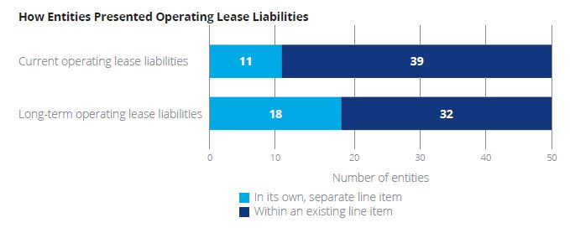
Feedback From Public Business Entity Adoption of Topic 842
Source: Deloitte Review of 50 of Fortune Top 125 disclosures

Slide 111
Financial Statement Presentation:
Statement of Comprehensive Income
Unwinding of discount and amortization of ROU asset:
  Finance – Separately
  Operating – Combined

Slide 112
Financial Statement Presentation:
Statement of Cash Flows
Lessors show cash receipts within operating activities
Cash Payments
Finance
Operating
Principal – Financing
Operating
Interest – Operating
Variable and short-term lease payments not
included in lease liability – Operating activities

Slide 113
Disclosures
Objective: allow users to assess the following:
  Timing of payments
  Amount of payments
  Uncertainty of cash flows
Consist of quantitative and qualitative disclosures for both lessees and lessors
See final standard for detailed listing of required disclosures
No specific relief for non-public entities

Slide 114
Summary of Qualitative ASC 842 Disclosures
Significant assumptions and judgments
  Whether a contract contains a lease
  Allocation of consideration in a contract
  Discount rate
Information about the nature of an entity’s leases
  General description
  Basis and terms and conditions on which variable lease payments are determined
  Terms and conditions of options to extend or terminate leases
  Residual value guarantees
  Restrictions or covenants imposed by leases
  Leases that have not yet commenced

Slide 115
Other Disclosures Related to ASC 842
Maturity analysis of lease liabilities
Related party lease transactions
Use of practical expedients
  Short-term leases
  Not separating lease and non-lease components
  Transition practical expedients
    Hindsight
    Package of three
Election not to restate comparative periods
Generally, all disclosures are required for all entities

Slide 116
Quantitative ASC 842 Lessee Footnote Disclosure – Income Statement

Slide 117
Footnote Disclosure – Other Required Quantitative Information

Slide 118
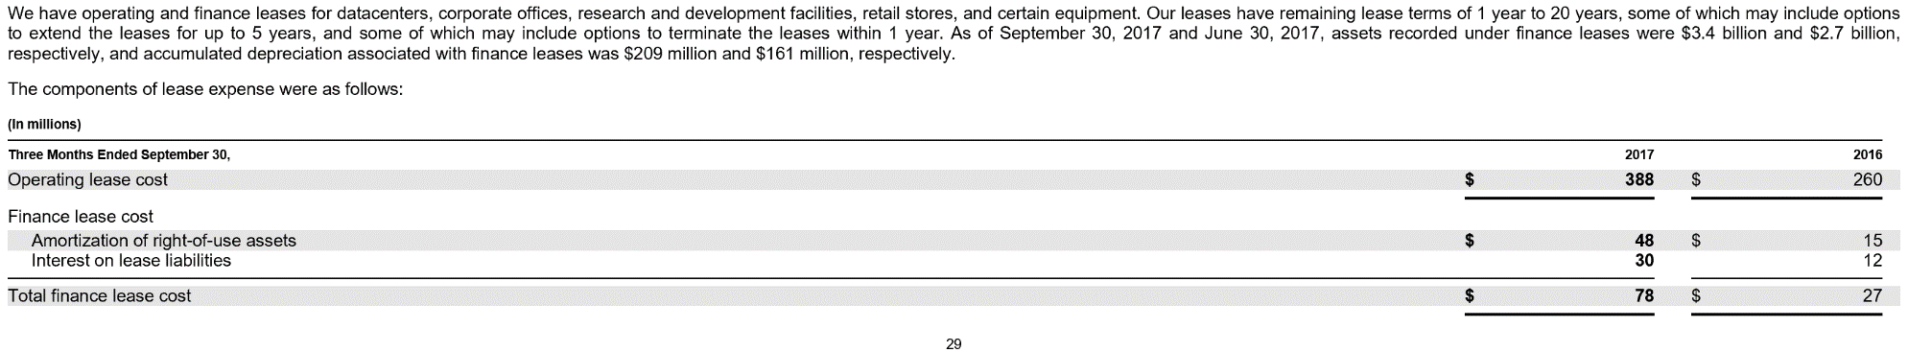
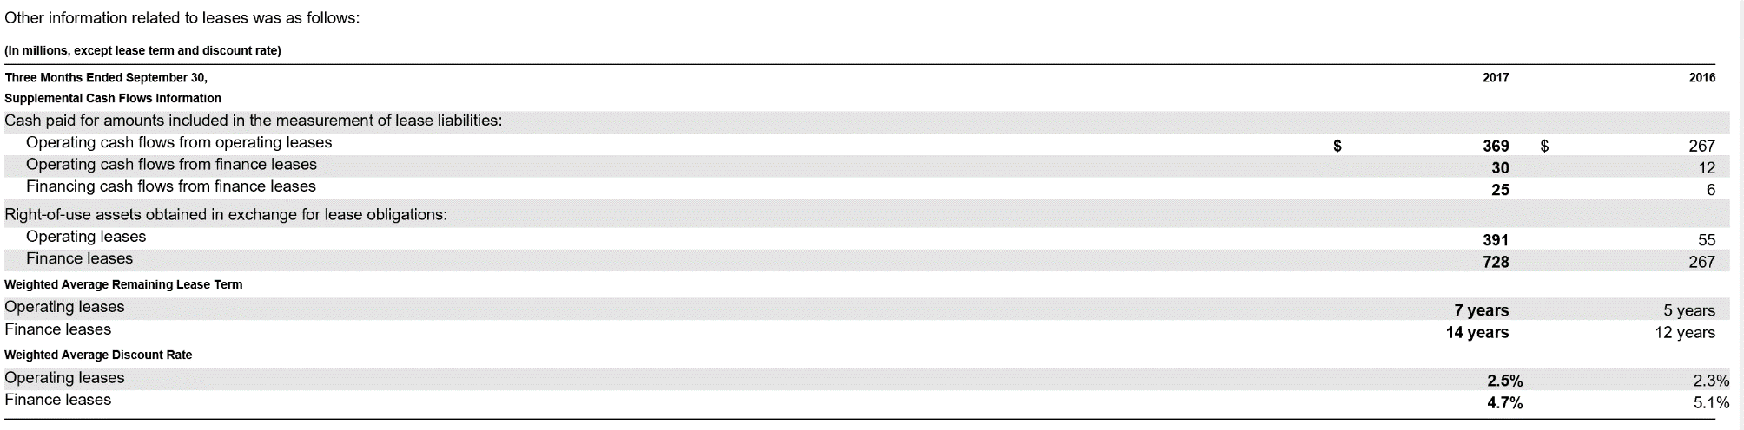
Example Lessee Disclosure

Slide 119
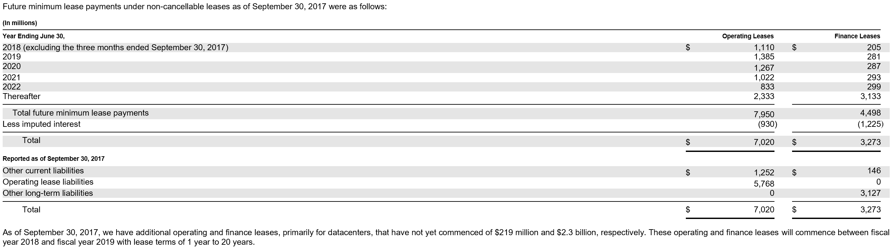
Example Lessee Disclosure
Entities should search the SEC’s EDGAR database for other examples of lease disclosures

Slide 120
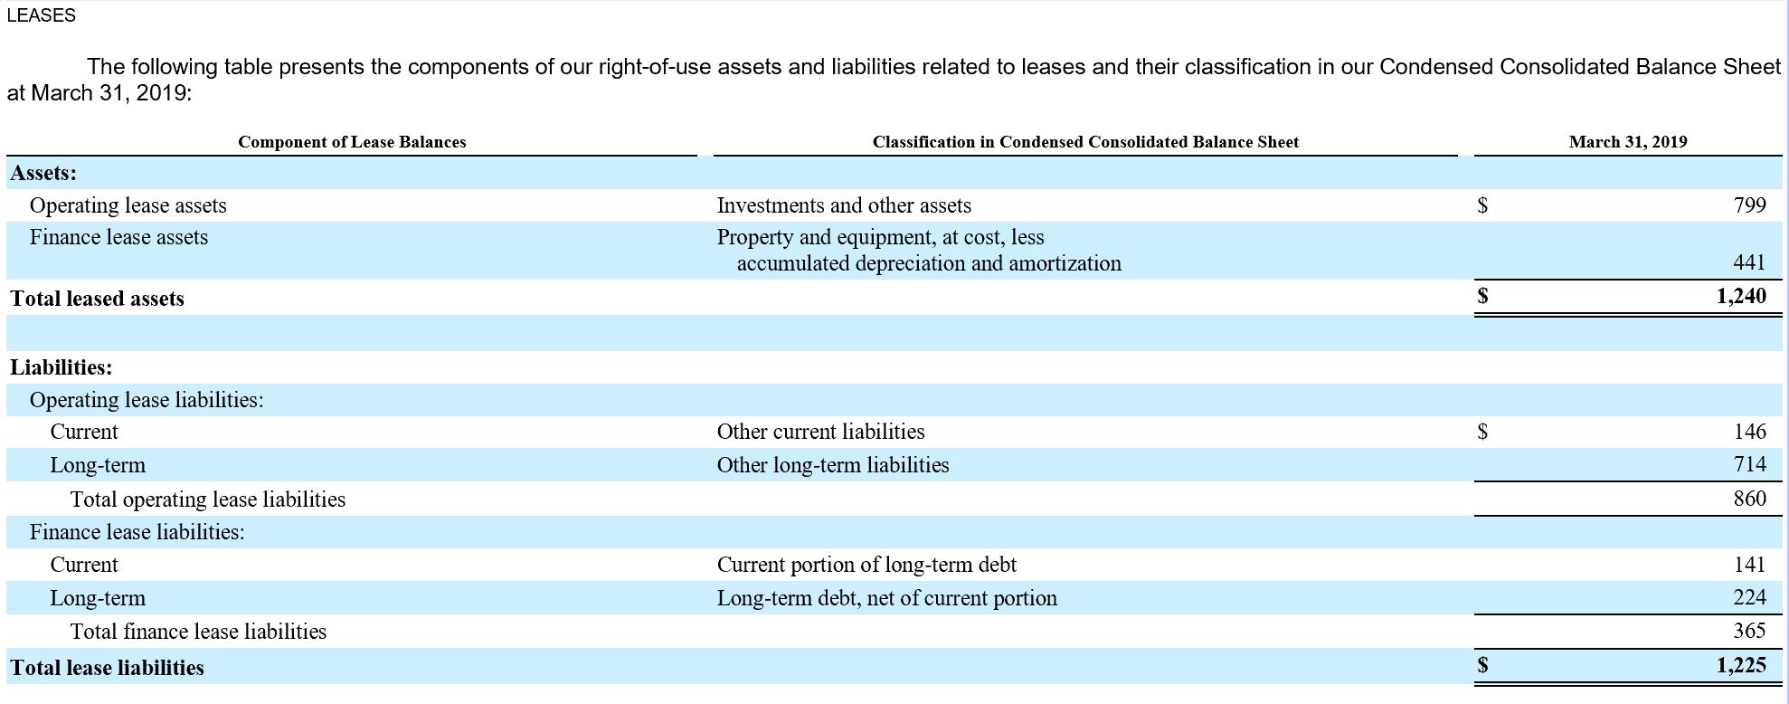
Example Lease Accounting Policy Footnote – Tenet Healthcare Corp.

Slide 121
Example Lease Accounting Policy Footnote – Tenet Healthcare Corp.
We determine if an arrangement is a lease at inception of the contract. Our right-of-use assets represent our right to use the underlying assets for the lease term and our lease liabilities represent our obligation to make lease payments arising from the leases. Right-of-use assets and lease liabilities are recognized at commencement date based on the present value of lease payments over the lease term. We use our estimated incremental borrowing rate, which is derived from information available at the lease commencement date, in determining the present value of lease payments. For our Hospital Operations and other Conifer segments, we estimate our incremental borrowing rates for our portfolio of leases using documented rates included in our recent equipment finance leases or, if applicable, recent secured debt issuances that correspond to various lease terms. We also give consideration to information obtained from our bankers, our secured debt fair value and publicly available data for instruments with similar characteristics. For our Ambulatory Care segment, we estimate an incremental borrowing rate for each center by utilizing historical and projected financial data, estimating a hypothetical credit rating using publicly available market data, and adjusting the market data to reflect the effects of collateralization

Slide 122
Example Lease Accounting Policy Footnote – Tenet Healthcare Corp.
Our operating leases are primarily for real estate, including off-campus outpatient facilities, medical office buildings, and corporate and other administrative offices, as well as medical and office equipment. Our finance leases are primarily for medical equipment and information technology and telecommunications assets. Our real estate lease agreements typically have initial terms of five to 10 years, and our equipment lease agreements typically have initial terms of three years. We do not record leases with an initial term of 12 months or less (“short-term leases”) in our consolidated balance sheets
Our real estate leases may include one or more options to renew, with renewals that can extend the lease term from five to 10 years. The exercise of lease renewal options is at our sole discretion. In general, we do not consider renewal options to be reasonably likely to be exercised, therefore renewal options are generally not recognized as part of our right-of-use assets and lease liabilities. Certain leases also include options to purchase the leased property. The useful life of assets and leasehold improvements are limited by the expected lease term, unless there is a transfer of title or purchase option reasonably certain of exercise. The majority of our medical equipment leases have terms of three years with a bargain purchase option that is reasonably certain of exercise, so these assets are depreciated over their useful life, typically ranging from five to seven years. Similarly, some of our leases of information technology and telecommunications assets include a transfer of title and, therefore, have useful lives of 15 years

Slide 123
Example Lease Accounting Policy Footnote – Tenet Healthcare Corp.
Certain of our lease agreements for real estate include payments based on actual common area maintenance expenses and others include rental payments adjusted periodically for inflation. These variable lease payments are recognized in other operating expenses, net, but are not included in the right-of-use asset or liability balances. Our lease agreements do not contain any material residual value guarantees, restrictions or covenants
We have elected the practical expedient that allows lessees to choose to not separate lease and non-lease components by class of underlying asset and are applying this expedient to all relevant asset classes. We have also elected the practical expedient package to not reassess at adoption (i) expired or existing contracts as to whether they are or contain a lease, (ii) the lease classification of any existing leases, or (iii) initial indirect costs for existing leases

Slide 124
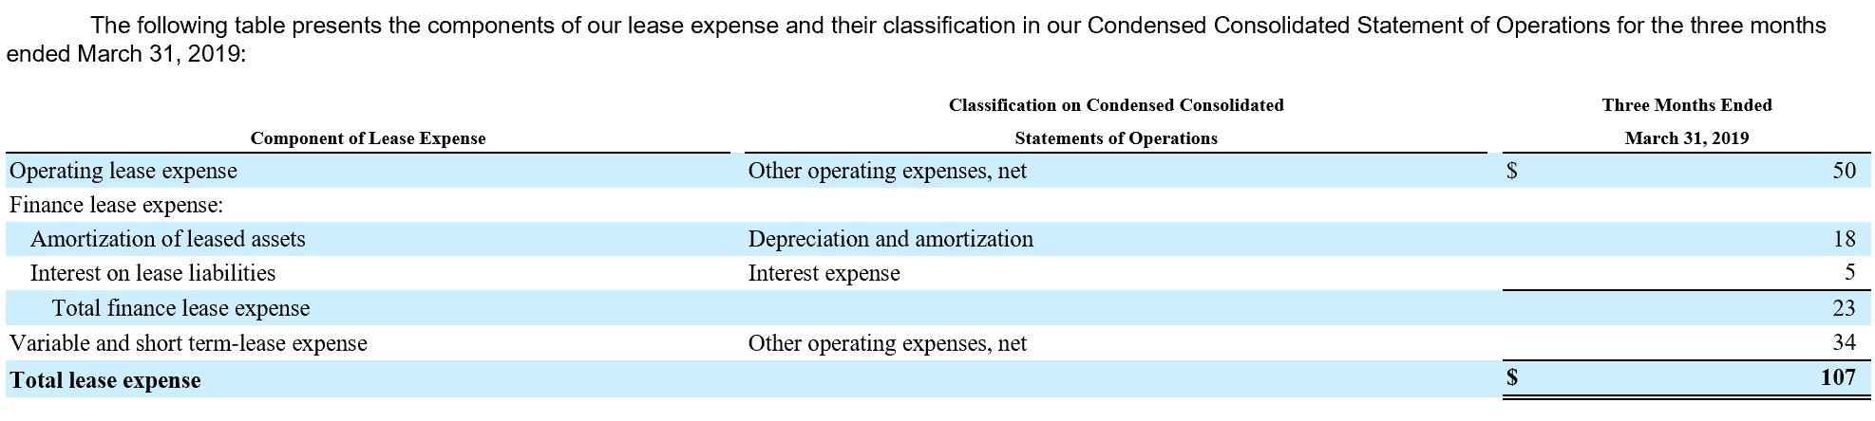
Example Lease Accounting Policy Footnote – Tenet Healthcare Corp.

Slide 125
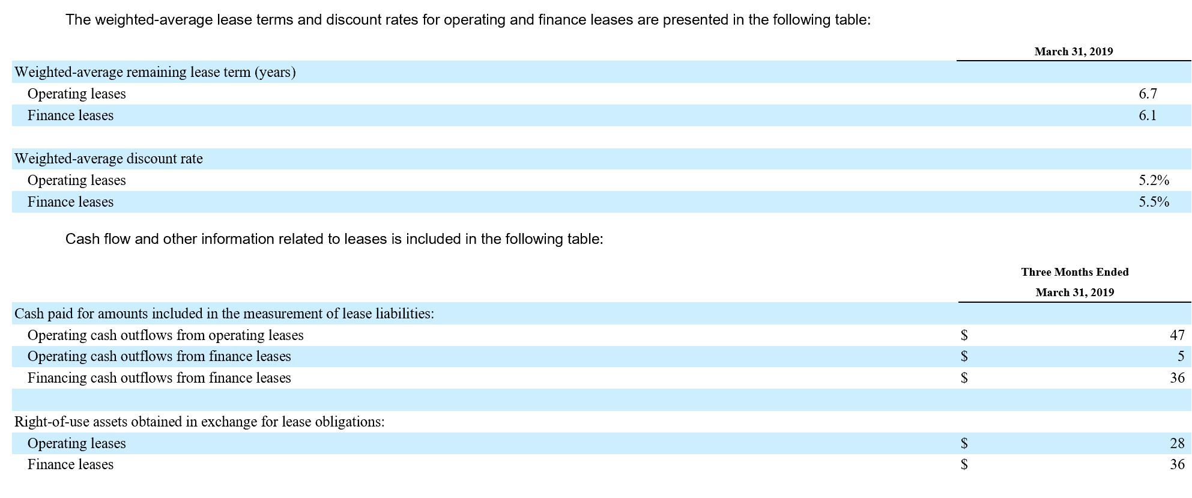
Example Lease Accounting Policy Footnote – Tenet Healthcare Corp.

Slide 126
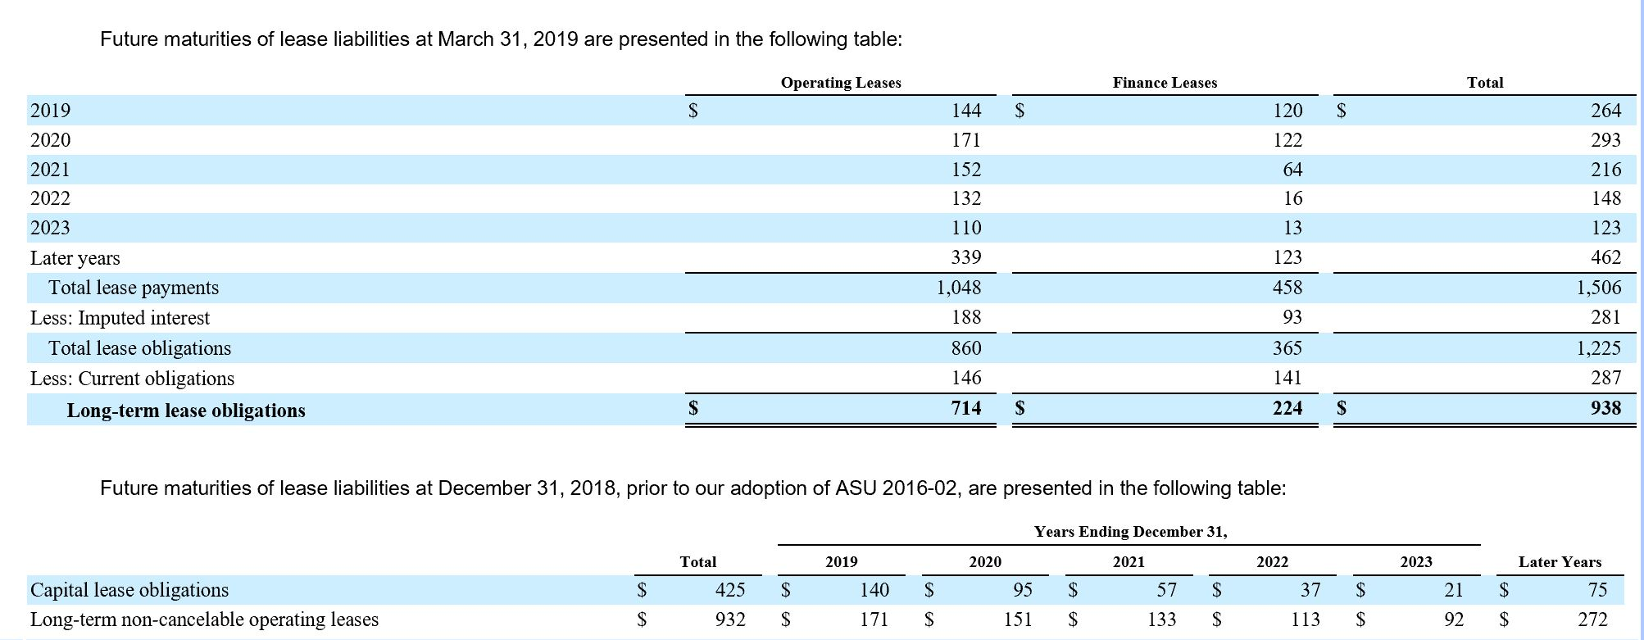
Example Lease Accounting Policy Footnote – Tenet Healthcare Corp.

Slide 127
Implications of Financial Statement Presentation Under Topic 842
Impact on liquidity ratios
Impact on debt/equity ratios
Impact on operating cash flows and EBITDA
  Operating lease payments reduce cash flows from operations in their entirely
  Amortization portion of operating lease expense is an add-back for EBITDA purposes
Entities should assess the impact adopting ASC 842 has on debt covenants and other contractual requirements as soon as possible

Slide 128
Lessee Transition

Slide 129
Transition
Modified retrospective approach
  Currently applied as of beginning of earliest period presented
  ASU No. 2018-11 allows entities to apply Topic 842 as of effective date, which would result in less effort to adopt
Topic 842 provides detailed guidance
Effective as follows:
  Public entities – Fiscal years beginning after December 15, 2018, including interim reporting during that year
  Non-public entities – Fiscal years beginning after December 15, 2021

Slide 130
Practical Expedients
Practical expedients available – Must adopt all three:
  No reassessment for embedded leases
  No reassessment for lease classification
  No reassessment of accounting for initial direct costs
Can use hindsight in determining lease term when considering options, termination, and impairment

Slide 131
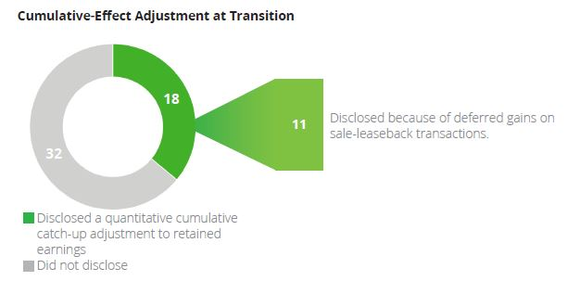
Feedback From Public Business Entity Adoption of Topic 842
Source: Deloitte Review of 50 of Fortune Top 125 disclosures

Slide 132
Lessee Transition Possible Outcomes – Modified Retrospective Approach
Existing capital lease to finance lease under Topic 842:
  Recognize ROU asset and liability as per Topic 840 at earlier of the beginning of the earliest comparative period or lease commencement
  Include IDC not capitalized under Topic 840 in ROU asset; otherwise, write-off to equity
  Before effective date, measure asset and liability in accordance with Topic 840
  At effective date, measure asset and liability in accordance with Topic 842
  Beginning at the effective date, modifications should be accounted for under the guidance of Topic 842

Slide 133
Lessee Transition Possible Outcomes – Modified Retrospective Approach
Existing operating lease to operating lease under Topic 842:
  Recognize an ROU asset and lease liability at the later of lease commencement or the beginning of the earliest period presented
  Liability measured as follows:
    Remaining minimum lease payments, per Topic 840; plus
    Discounted amounts lessee expects to pay under residual value guarantee
  ROU asset measured as follows:
    Lease liability, adjusted for impairment, prepaid or accrued rent, lease incentives, IDC that would be capitalized under Topic 842 and any disposal cost obligations recognized under Topic 420
  Write-off to equity any IDC not eligible for capitalization under Topic 842
  Account for modifications after the effective date using Topic 842

Slide 134
Lessee Transition Possible Outcomes – Modified Retrospective Approach
Existing capital lease to operating lease under Topic 842:
  Derecognize the carrying amount of the capital asset and lease liability at the later of the beginning of the earliest comparative period or lease commencement
    Difference between these amounts should be accounted for as prepaid or accrued rent
  Recognize ROU asset and lease liability in accordance with Topic 842
  Account for subsequent measurement under Topic 842

Slide 135
Lessee Transition Possible Outcomes – Modified Retrospective Approach
Existing operating lease to finance lease under Topic 842:
  Measure ROU asset as applicable portion of the lease liability at commencement (imputed from lease liability
  Adjust ROU asset recognized by any prepaid or accrued lease payments and the carrying amount of any liabilities related to disposal recognized per Topic 420

Slide 136
Consideration of Variable Rentals Under Topic 840
Under Topic 840, minimum lease payment disclosure includes variable payments based on a rate or index
  Included based on rate or index at lease inception
Disparity in practice concerning updating disclosure for changes in rate or index
  Some do not update disclosure for changes
  Some use current rate or index when developing the disclosure
  Topic 842 provides no specific guidance
If using rate or index at inception of lease
  Continue to do so at transition; or
  Use current rate or index but apply ASC 250 guidance

Slide 137
Discount Rate Considerations in Transitioning to Topic 842
Discount rate is determined at the application date
  Date of application of Topic 842
  Will differ based on elected transition approach
Same discount rate options exist as when originally recording a lease under Topic 842
  Use rate inherent in the lease, if known
  Use incremental borrowing rate, if not known
    May use rate for original term or remaining term of the lease, at transition
    Approach should be consistently applied
  Non-public business entities can use the risk-free rate

Slide 138
Lessee Transition Example: Operating Lease Under ASC 840 and 842
On January 1, 20X2, the lessee measures the lease liability at $112,462, the present value of one payment of $31,000 and three payments of $33,000, discounted at 6 percent
  Right-of-use asset $112,462
  Lease liability $112,462
The lessee also makes an adjustment to the right-of-use asset for the amount of the previously recognized accrued rent
  Accrued rent $1,200
  Right-of-use asset $1,200

Slide 139
Lessee Transition Example: Operating Lease Under ASC 840 and 842
Election of the “Group of Three” practical expedients
A lessee that is a calendar-year public business entity entered into a 10-year lease of equipment that commenced on 1 January 2017 and was classified as an operating lease under ASC 840. The lessee makes annual payments that it pays in arrears on 31 December each year. The initial payment was $10,000, and the terms call for a $1,000 increase each year
The deferred rent liability on 31 December 2018 is $8,000. The lessee incurred $7,500 of initial direct costs (IDCs) and half of the remaining unamortized IDCs of $6,000 qualify for capitalization under ASC 842 at lease commencement (i.e., $3,000 of remaining unamortized IDCs qualify for capitalization under ASC 842 at lease commencement)

Slide 140
Lessee Transition Example: Operating Lease Under ASC 840 and 842
The lessee elects to apply the package of practical expedients at transition and does not elect to apply the hindsight practical expedient. Therefore, lease classification and the remaining unamortized IDCs of $6,000 are not reassessed
The lessee cannot determine the rate implicit in the lease, and its incremental borrowing rate (IBR) as of 1 January 2019 is 5 percent
Finally, the lessee elects to apply the transition provisions at the beginning of the period of adoption (i.e., 1 January 2019)

Slide 141
Lessee Transition Example: Operating Lease Under ASC 840 and 842
Analysis: in this example, the lessee records the following journal entry as of 1 January 2019:
  Right-of-use asset $96,529 (1)
  Deferred rent liability 8,000 (2)
  Lease liability $ 98,529 (3)
  Capitalized IDCs 6,000 (4)
The ROU asset equals the lease liability determined in (3) less the deferred rent liability determined in (2) plus remaining unamortized IDCs ($98,529 – 8,000 + 6,000)
The deferred rent liability is the difference between the cash payments of $21,000 for 2017 and 2018 and cumulative straight-line expense of $29,000 ($14,500 per year for 2017 and 2018)
The lease liability is the present value of the eight remaining rental payments discounted at the incremental borrowing rate of 5 percent ($98,529)
The unamortized portion of IDCs capitalized under ASC 840 ($7,500 – 1,500 for two years of amortization)

Slide 142
Lessee Transition Example: Operating Lease Under ASC 840 and 842
Assume the same facts as in Scenario A except the lessee does not elect to apply the package of practical expedients at transition
Analysis: in this example, the lessee records the following journal entry as of 1 January 2019:
Right-of-use asset $93,529 (1)
Deferred rent liability 8,000 (2)
Cumulative-effect adjustment 3,000 (3)
Lease liability $98,529 (4)
Capitalized IDCs 6,000 (5)

Slide 143
Lessee Transition Example: Operating Lease Under ASC 840 and 842
The ROU asset equals the lease liability determined in (4) less the deferred rent liability determined in (2) plus remaining unamortized IDCs that qualify for capitalization under ASC 842 ($98,529 – $8,000 + $3,000)
The deferred rent liability is the difference between the cash payments of $21,000 for 2017 and 2018 and cumulative straight-line expense of $29,000 ($14,500 per year for 2017 and 2018)
The cumulative-effect adjustment is the portion of remaining unamortized IDCs that do not qualify for capitalization under ASC 842 ($6,000 remaining unamortized IDCs [$7,500 – $1,500 for two years of amortization] x 50 percent)
The lease liability is the present value of the eight remaining rental payments discounted at the incremental borrowing rate of 5 percent ($98,529)
The unamortized portion of IDCs capitalized under ASC 840 ($7,500 – $1,500 for two years of amortization) (half was included in the measurement of the ROU asset, and the portion that does not qualify for capitalization under ASC 842 was adjusted in (3))

Slide 144
Lessee Transition Disclosures
Lessees and lessors should provide transition disclosures consistent with ASC 250, Accounting Changes and Error Corrections
Entities can omit the disclosure of the effect of the change on income from continuing operations, net income, any other affected financial statement line item, and any affected per-share amounts for the current period and any prior periods retrospectively adjusted.

Slide 145
Lessor Accounting

Slide 146
Lessor Accounting Under ASC Topic 842
Approach similar to current guidance in ASC Topic 840
Classification based on passage of risks and rewards
Sales-type/direct financing:
  Derecognize underlying asset
  Receivable for amounts due from lessee
  No profit recognized if control does not pass
Operating lease:
  Continue to recognize underlying asset and depreciation
  Recognize lease income over life of the lease
Must consider collectability, as per ASC Topic 606

Slide 147
Accounting for Sales-Type Leases – The Details
At commencement date:
  Derecognize underlying asset
  Record net investment in lease
    Lease receivable – PV of the following:
      Lease payments
      Residual value guarantee
    PV of expected unguaranteed residual value at end of lease
  Record selling profit or loss
  Record initial direct costs
Similar for direct financing lease except no selling profit or loss

Slide 148
Accounting for an Operating Lease
Underlying asset remains on the books of lessor and continues to be depreciated
Lease payment is recorded as lease income on a straight-line or other reasonable basis
Amortization of initial direct costs
Variable lease payments are included in income statement in period in which they are earned

Slide 149
Other Lessor Considerations
Collectibility threshold of ASC Topic 606 must be met for sales-type or direct financing lease:
  Defer gain or loss on sale if not met
  No asset derecognition and cash received recorded as deposit payable
Impairment:
  Operating lease – Consider impairment under ASC
  Topic 360
  Sales-type and direct financing lease – Consider impairment under ASC Topic 310

Slide 150
Accounting for Initial Direct Costs
Accounting differs based on classification of lease
Sales-type lease:
  If FV is different from carrying amount – Expense at commencement
  If FV and carrying value are equal – Defer and include in measurement of net investment in lease via determination of interest rate
Direct financing lease – Defer and include in net investment in lease
Operating lease – Defer and recognize over lease life

Slide 151
Subsequent Measurement – Sales-Type and Direct Financing Leases
Periodically:
  Increase the net investment in lease to record interest income
  Reduce net investment for lease payments
Net investment in lease should be evaluated for impairment in accordance with ASC Topic 310, Receivables, not ASC Topic 360, Property, Plant and Equipment

Slide 152
Determination of Selling Profit or Loss
Selling profit or loss consists of the following:
  Lower of the fair value of the underlying asset or the sum of the lease receivable and any prepayments
  Less:
  The carrying amount of the underlying asset, net of any unguaranteed residual asset
  Less:
  Any deferred initial direct costs of the lessor

Slide 153
Applying the Guidance
Illustration – Accounting for a sales-type lease where carrying amount of the underlying asset equals its fair value

Slide 154
Illustration Journal Entries
Lease commencement:
  Lease receivable $6,513 – PV of lease payment + IDC
  Residual asset 3,687 – PV of unguaranteed residual
    Vehicle 10,000 – Underlying asset
    Cash or A/P 200 – Initial direct costs
Periodic income recognition:
Cash $2,400 – periodic lease payment
Interest income 447 ($6,513 x 6.87 percent)
Lease receivable 1,953 ($2,400 – 447)

Slide 155
Leveraged Leases
Guidance in ASC Topic 840 not carried forward to ASC Topic 842
Generally entered into for tax purposes:
  Tax credits available to lessor could be passed on to lessee, effectively lowering interest rate of lease
Existing leveraged leases are grandfathered
Specific criteria for lessors to meet
Carrying value of asset is lease receivable less debt

Slide 156
Lessor Financial Statement Presentation
Statement of financial position:
  Sales-type/direct financing – Net investment in lease presented separately
  Operating lease – Present asset per other GAAP
Statement of income:
  Present as lease income for all leases
  Profit or loss on sale presented in accordance with business model
Statement of cash flows:
  All cash flows presented as operating
Qualitative and quantitative disclosures

Slide 157
Treatment of Sales and Property Taxes by Lessors
The FASB issued ASU No. 2018-20 in December 2018 and addressed the following:
  As consistent with Topic 606, entities may make a policy election to exclude from the transaction price all sales and similar taxes imposed on the transaction that are collected by the entity from a customer
  Lessors should exclude from variable payments certain lessor costs such as property taxes which are paid directly by the lessee to third parties. Such costs paid to third parties by the lessor and reimbursed by the lessee would be considered variable payments
  Variable payments received by the lessor should be allocated between the lease and non-lease components, as applicable, with payments allocated to the lease recognized as income per Topic 842. Payments allocated to non-lease components would be accounted for under other applicable guidance

Slide 158
Lessor Transition

Slide 159
Lessor Modified Retrospective Approach
Existing sales-type/direct financing leases:
  No need to reassess if selling profit should be recognized
  Recognize net investment in lease, per Topic 840, at the later of lease commencement or initial application
  Before effective date, measure under Topic 840
  At effective date, begin to measure under Topic 842
Existing sales-type/direct financing to operating lease under Topic 842:
  Derecognize any net investment in lease
  Recognize the leased asset at the carrying amount that it would have been under Topic 840
  Difference is recorded to equity

Slide 160
Lessor Modified Retrospective Approach
Existing operating leases:
  Carrying amount of leased asset and related accounts should be the same as under Topic 840
  Recognize IDC costs eligible for capitalization under Topic 842 and expense over the life of the lease
Existing operating to a sales-type/direct financing lease under Topic 842:
  Derecognize underlying asset at later of commencement date or beginning of earliest year presented
  Recognize net investment in lease as if the lease would have been classified as such under Topic 842 at its commencement
  Difference is recorded to equity

Slide 161
Sales/Leaseback Transactions

Slide 162
Sales/Leaseback Transactions
Typically real estate or large capital items
May provide financing, accounting, or tax benefits
Sales/leaseback transactions should be accounted for per guidance in ASC Topic 842

Slide 163
Recognition of a Sales/Leaseback
Recognition based on whether initial transfer is a sale
Criteria of ASC Topic 606, Revenue from Contracts with Customers, must be met for a sale to have occurred
The mere presence of a leaseback does not preclude the buyer/lessor from obtaining control
If leaseback is a sales-type lease, control has not passed, and no original sale has occurred

Slide 164
Accounting for Sales/Leaseback Transactions
Transfer is a sale:
  Seller accounts for transaction as a sale
    Derecognize asset when control passes to buyer
    Account for leaseback under ASC Topic 842 lessee guidance
  Buyer accounts for sale as a purchase and leaseback using lessor guidance of ASC Topic 842
Transfer is not a sale:
  No asset derecognition by seller
  Seller/lessee – Account for as financial liability
  Buyer/lessor – Account for amount due as a receivable

Slide 165
Measurement in a Sales/Leaseback Transaction
Determine if transaction is at fair value:
  Compare sales price to fair value of asset; or
  Compare PV of lease payments to PV of rentals
If transaction is not a fair value, adjust selling price of asset:
  Increase in selling price accounted for as prepaid rent
  Decrease in selling price accounted for as additional financing

Slide 166
Build-to-Suit Arrangements
New model in ASC Topic 842
Lessee is deemed owner of asset under construction if the lessee controls the asset during the construction period:
  Criteria for control listed in ASC Subtopic 842-40-55-5
Lessee costs recorded in accordance with ASC Topic 330, Inventory, or Topic 360, Property, Plant and Equipment
If the lessee controls the asset prior to commencement, the transaction is accounted for as a sales/leaseback transaction

Slide 167
Accounting for Deferred Gain on a Sales/Leaseback Transaction
Original sales accounted for as a sale and capital leaseback under ASC 840:
  Continue to recognize any deferred gain or loss from original transaction
  Recognize deferred gain or loss after transition as follows:
    If the underlying asset is land only, straight line over the remaining lease term
    If the underlying asset is not land only and the leaseback is a finance lease, in proportion to the right of use asset
    If the underlying asset is not land only and the leaseback is an operating lease, in proportion to the recognition in profit or loss of the total lease cost

Slide 168
Accounting for Deferred Gain on a Sales/Leaseback Transaction
Original sales accounted for as a sale and operating leaseback under ASC 840:
  Recognize any deferred gain or loss not resulting from off-market terms as a cumulative-effect adjustment to equity
  Recognize any deferred loss resulting from the consideration for the sale of the asset not being at fair value or the lease payments not being at market rates as an adjustment to the leaseback right-of-use asset
  Recognize any deferred gain resulting from the consideration for the sale of the asset not being at fair value or the lease payments not being at market rates as a financial liability

Slide 169
Transition for Sales/Leaseback Accounted for as a Failed Sales/Leaseback Under Topic 840
Reassess under guidance of ASC 842 to determine whether a sale would have occurred at the effective date
If a sale would have occurred, the sale and leaseback transaction should be accounted for using the lease transition guidance on a modified retrospective basis from the date that a sale is determined to have occurred

Slide 170
Other Lessor Transition Issues
Sales/leaseback transactions:
  No need to reassess if transaction would be classified as a sale
  Account for leaseback as per the transition requirements for lessors
Existing build-to-suit arrangements:
  Derecognize assets and liabilities recognized as a result of built-to-suit designation under Topic 840, with difference to equity
  Follow lessee transition guidance for lease itself as it would have if it was not accounted for under the existing build-to-suit guidance
Transition disclosures as required under ASC Topic 250, Accounting Changes and Error Corrections, should be followed

Slide 171
Other Considerations
in Adopting Topic 842

Slide 172
Accounting for Leases Acquired in a Business Combination
Acquiree’s lease classification is retained
Apply modification guidance if terms of lease change
If acquiree is a lessee:
  Record lease liability at the present value of the future lease payments, as of the transaction date and a corresponding ROU asset
If acquiree is a lessor:
  Sales-type or direct financing – Record net investment in lease at lease fair value, determined at transaction date
  Operating lease
    Record underlying asset at fair value
    Record as asset or liability the amount that differs from current market

Slide 173
ASC 842 Impact on ASC 740, Income Taxes
Tax impact:
  Standard does not impact tax treatment of leases
  State apportionment factors
  Local country tax impact and impact in repatriation
  Assess impact on current book/tax differences

Slide 174
Common Mistakes to Avoid
Timing of Systems vs. Process
  Don’t leap straight to entering leases in a system
  Priorities should be:
    Identify full lease portfolio by asset class
    Thoughtful policy elections
    Understand lease payment process and GL accounts
Use of spreadsheets
  Error prone
  Quantitative footnote disclosure is complicated
  Lease revisions – Difficult to “freeze” spreadsheet reporting
  CPA firms might charge more to audit a spreadsheet

Slide 175
Common Mistakes to Avoid
Booking a Cumulative Effect of Change in Accounting Principle
  Adjust ROU Asset instead
  Certain it goes to equity? Contact your CPA firm.

Slide 176
Common Mistakes to Avoid
Lease Term Renewals
  Not just “I think we’ll renew”
  High bar – Economic incentives matter
  Related party – Relationship doesn’t matter for term

Slide 177
Unexpected Business Impacts
Maturity analysis includes more leases
  Not just real estate and office space
  Smaller leases add up
Debt Covenants
  Dependent on individual terms
  Work with bank early
  Run pro-forma numbers as early as possible
  Could impact availability or cost of capital
Cost of financing
  Lease vs. buy?

Slide 178
Simplifying Implementation

Slide 179
Steps to Simplify Implementation
Be organized
  Project management
  Lease inventory by reviewing payments
  Embedded lease assessment
Inclusive decisions
  Transition vs. ongoing identification
  Not just accounting. Make sure to include the following:
    Procurement
    Operations, including location managers
    Finance
    Accounts payable
    Legal, as necessary

Slide 180
ASC 842 Top 10 Implementation Tips
Identify all leases for transition
Review December 31, 2021, 5 Year Payment Table
Finalize assumptions and policy elections
Determine discount rate
Review new leases under ASC 842
Finalize use of software
Plan to calculate the transition adjustment
Determine impact on debt covenants
Develop a process to identify and assess embedded leases
Don’t procrastinate

Slide 181
Thank you!

